Slide 1
Using Demonstrative Exhibits Effectively
Southern District of Texas Bankruptcy Bench Bar Conference
April 20-22, 2016

Slide 2
What is a Demonstrative Exhibit?
Black’s Law Dictionary: Physical evidence that one can see and inspect (i.e., an explanatory aid, such as a chart, map, and some computer simulations) and that , while of probative value and offered to clarify testimony, does not play a direct part in the incident in question.
Jones Definition: Something that makes your case more interesting and easier to understand.
Photographs / Videos
Charts / Graphs
Summaries
Whiteboard Use
Must be authenticated pursuant to the Rules of Evidence.

Slide 3
Photographs / Videos
Generally authenticated by the testimony of a person with knowledge of the matter depicted.
Testimony must show that the photograph or video fairly and accurately depicts the matter in question.

Slide 4
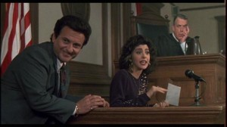
Diagrams, Charts, and Graphs
Used to help clarify the testimony of the witness (not substitute).
Predicate of accuracy is necessary, even if only admitted for demonstrative purposes.

Slide 5
Authentication
Federal Rule of Evidence 901. Generally, you can establish the authenticity of a picture or other document under Fed. R. Evid. 901(a) by posing a very simple set of questions to a witness with personal knowledge:
Q: Can you identify as Exhibit 1?
A: Yes.
Q: What is it?
A: It is a picture of Judge Isgur’s 1972 Ford pinto.
Q: Is this an accurate picture of Judge Isgur’s car?
A: Yes. It’s the only lime green pinto I’ve ever seen.
Assuming that the witness has personal knowledge and can answer the foregoing questions (See Fed. R. Evid. 602), YOU HAVE AUTHENTICATED THE PICTURE.

Slide 6
What is not Effective?
Demonstrative Exhibits are not a crutch

Slide 7
Do not talk from the Power Point
The Power Point is a presentation tool…not magic.

Slide 8
What is Effective?
(1) Knowing your audience.
(2) Having a conversation, not a lecture.
(3) Telling a story.
If the demonstrative exhibit takes away from (1),(2), or (3), do not use it.

Slide 9
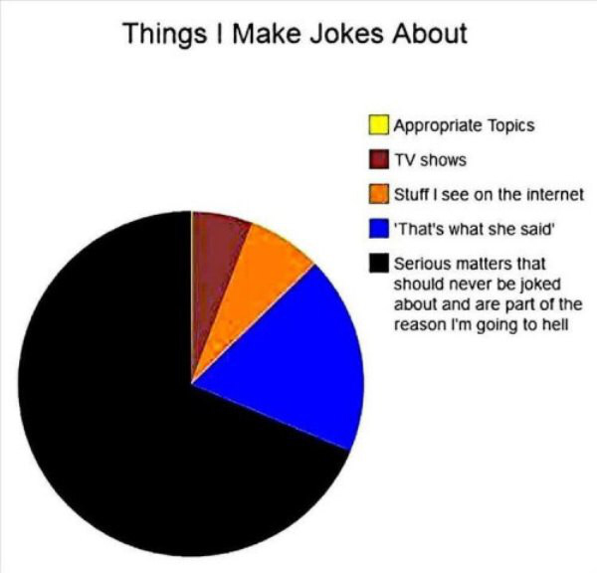
Who doesn’t love pie?

Slide 10
Would it enhance your presentation if you had this exhibit to assist the witness in giving testimony about the location of the subject property?

Slide 11
Can words really describe the scope of this problem?

Slide 12
Does this enhance the witness’ testimony that no inspection occurred?

Slide 13
Does this add perspective that threading was to be completed within 30 days of pipe being delivered?

Slide 14
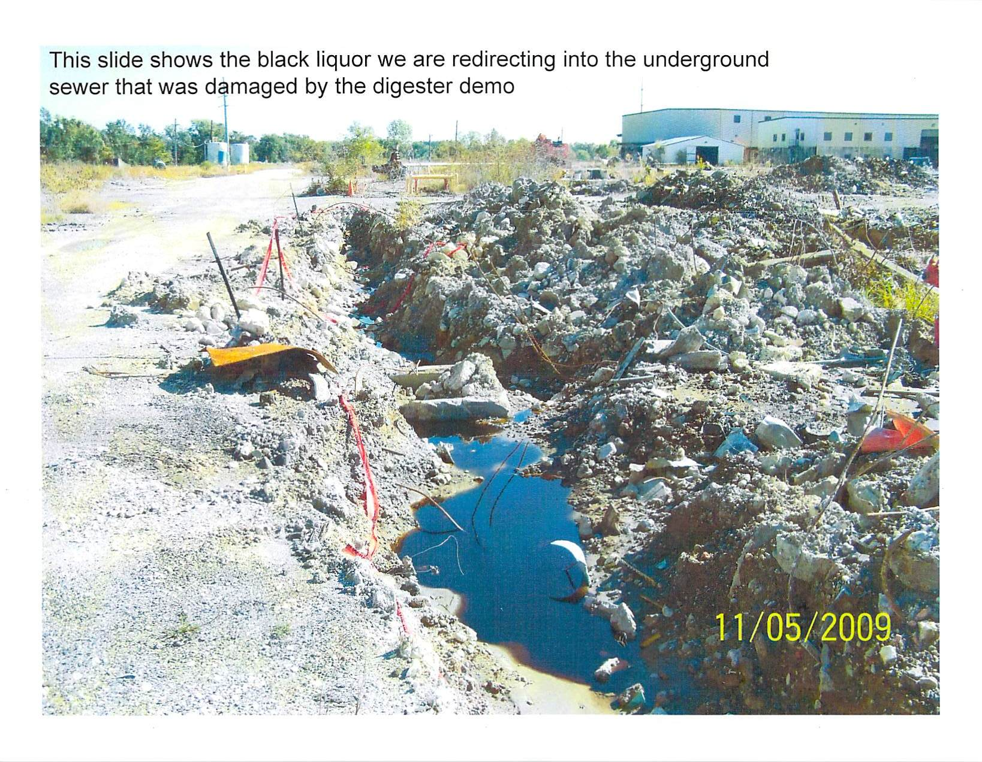
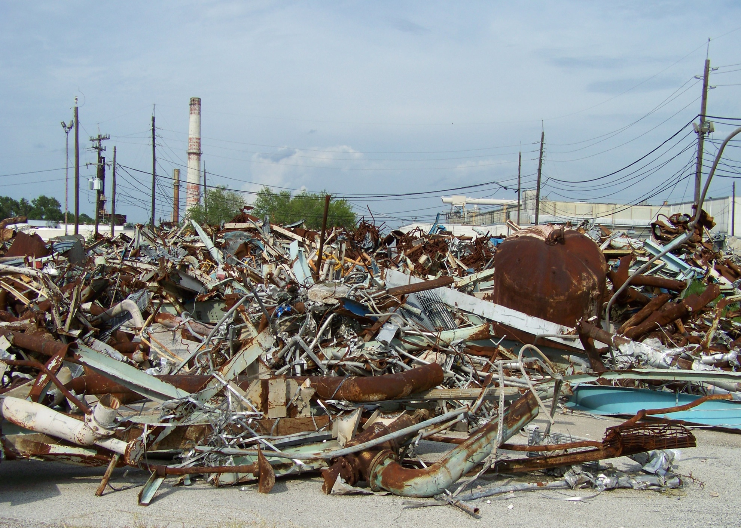
Does this picture add or subtract from testimony that an environmental problem exists?

Slide 15
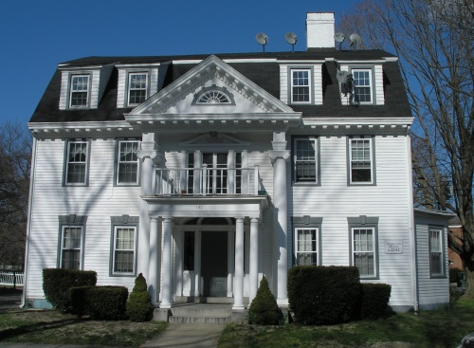
Does this add real life context?
Before the flood…
After the flood. . .

Slide 16
Do you want the judge to have this in chambers?
SCC
CPC
BARBADOS
MHTL TRINIDAD
10
Notes:
Slide too busy with Germany/AG lines cross went with second option in your email

Slide 17
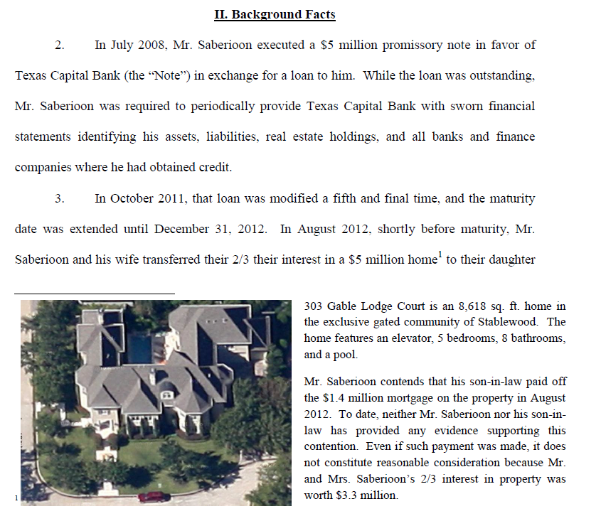
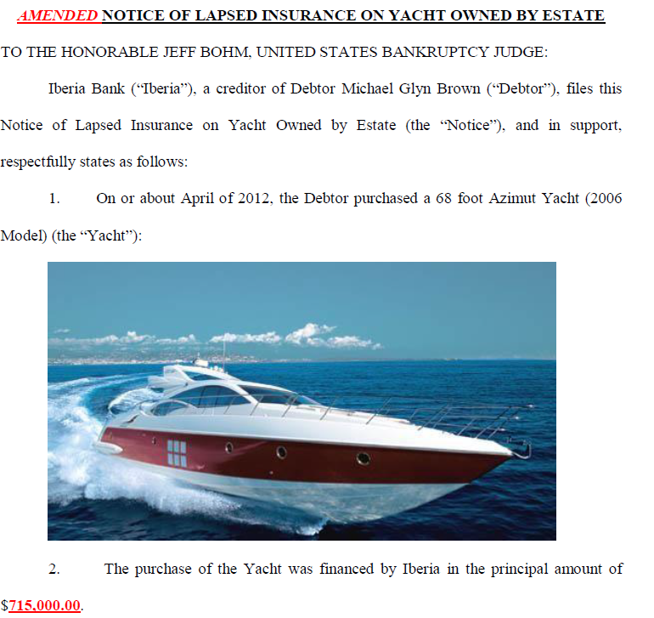
…then why not use one in a pleading?

Slide 18
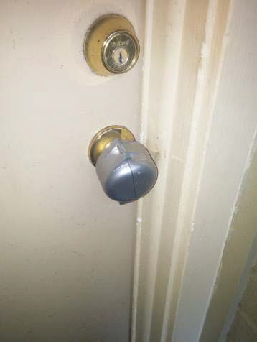
What would you think?
20. On November 9, 2015, Mr. X’s daughter came home from school and was unable to enter her home because the Defendant had placed a lock on Mr. X’s home and locked both Mr. X and his daughter out. Mr. X’s daughter sent him this picture of what was on the door and what was keeping her from going inside her home:

Slide 19
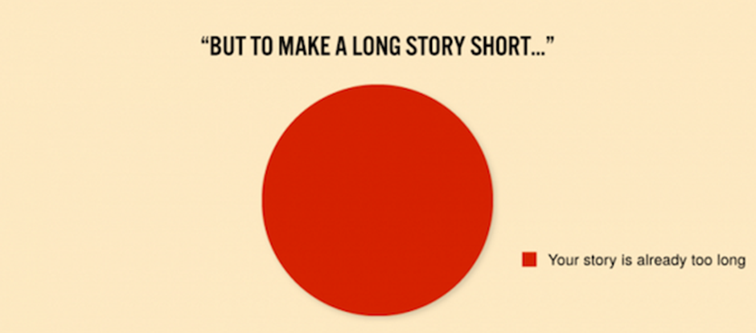

Slide 20
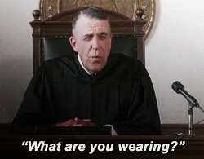
Questions?

