Slide 1
The ABCs of Claim Objections
Southern District of Texas Bench Bar Conference
April 19, 2022
Victoria Argeroplos – Jackson Walker LLP
Veronica Polnick – Jackson Walker LLP
Martha Wyrick – Haynes and Boone, LLP

Slide 2
The Basics
11 U.S.C. § 502: Unless objected to, a claim is Allowed
11 U.S.C. § 502(b), (d), (e): different bases for disallowance of a claim
FRBP 3001: form of the claim, who may execute the claim, and the supporting information that may be required
A claim that complies with these rules is prima facie evidence of the validity and amount of the claim
When objecting, the objector bears the burden to rebut the prima facie validity of the claim by offering evidence that refutes at least one of the allegations that is essential to the claim’s legal sufficiency
Burden shifts back to the claimant to prove by a preponderance of the evidence the amount and validity of the claim
A claimant’s burden is heightened when it is an “insider” of the debtor; must show inherent fairness and good faith
Exceptions: State law determines burden; e.g., burden of proof on a tax claim remains with the taxpayer
FRBP 3002: need, time, place for filing a proof of claim
FRBP 3007: establishes the process for objecting to claims, including:
Time and manner of service
Basis for omnibus objections and procedures

Slide 3
Why we are all here: The Debtor doesn’t owe the money!
Under § 1106(a)(1), Debtor has a duty to object to improper claims
An objection to the claim must be under a basis articulated in § 502(b)
Examples: claim is unenforceable against the Debtor, claim is for unmatured interest
Courts are divided on whether § 502 provides the exclusive grounds to object
Is technical noncompliance (such as failure to attach supporting documentation) with the rules sufficient to justify a claim objection?
Objection should state the process undertaken in evaluating the claim
State the relief sought in the objection and the order:
Reduce the claim to $x
Allow the claim as a general unsecured claim rather than priority, unsecured
Reclassify the claim as an interest
Ensure the objection is properly served

Slide 4
What Makes a Good Declaration in Support of a Claim Objection?
Do you really need a declaration?
What is the declaration for??
Rule 3001: must refute at least one allegation that is essential to the claim’s legal sufficiency
What are the elements of the claim?
Who would have personal knowledge of the necessary facts to refute the allegations in the claim?
Use plain English and remember the key point - the debtor is not obligated on the claim
There should be no legal argument in the declaration.
A declaration is testimony; make sure the declarant can testify to what is in the declaration
The declarant should state the factual basis for disallowance under section 502
Explain the process undertaken in evaluating the claim and how you reached the conclusion. Be specific in the process instead of just relying on “books and records”
Examples of what works

Slide 5
Who, What, Where, Why, and How?
Who filed this claim?
Former employee
Personal injury claimant
Trade vendor
Landlord
Taxing authority
What is the claim based on?
Goods or services
Slip and fall
Wrongful termination
Rent or rejection damages
Where did the Debtor look to find the relevant facts about this claim?
“the Debtor’s PeopleSoft employee records system”
“the Debtor’s Oracle R12 accounts payable system”
“the Debtor’s legal files and loss reports”
Why am I objecting to this claim? 502, 503, 506, 507
Claim asserts damages for personal injury for which the debtor denies liability
Claim is for goods not received within the 20 days before the petition date
Claim asserts secured status but is really unsecured
Claim is for wages earned >180 days before petition date
I disagree with the amount
How did I come to the conclusion that the debtor isn’t liable?
The goods were actually delivered on X date, or were never delivered
The employee was terminated >180 days before the petition date
The lease was rejected as of [date], therefore the rejection damages are $__
I’ve paid my taxes already
The debtor isn’t at fault for the claimant’s injury

Slide 6
Omnibus Claim Objections
Tip: Comply with the Code, Rules, and Local Rules & include the financial advisor early on.
FRBP 3007(d): omnibus claim objection grounds -
(0) Filed by the same claimant
(1) Duplicate
(2) Wrong Debtor
(3) Amended
(4) Late filed
(5) Satisfied
(6) “they were presented in a form that does not comply with applicable rules, and the objection states that the objector is unable to determine the validity of the claim because of the noncompliance.”
(7) Interest rather than claim
(8) Priority in amount greater than allowed under 507

Slide 7
Omnibus Claim Objections
Body of Objection / Declaration vs.
“These claims have been satisfied during the pendency of the case”
“These claims are not entitled to priority under 507(a)(4) because they are not based on wages earned within the 180 days before the petition date”
Description of Claims on Schedules
“This claim was paid [in full/part] via [method] on [date]” “This employee was fired on [date]”
“This claimant was an independent contractor rather than an employee”

Slide 8
Expanding 3007(d)
Expand 3007(d) through court-approved procedures, may include:
Expand objections beyond 100 claims
Include incorrectly classified claims
Filed against non-debtor
Categorize unliquidated litigation claims by type (e.g., employee versus personal injury)
Consider a form for withdrawing a proof of claim after an objection is filed
Consider a notice of satisfaction, instead of an objection
Require a declaration or evidence when a response is filed?
Is a notice of omnibus objection procedures necessary?

Slide 9
Claim Objections that Don’t Work
Objection based solely on “books and records”
“I just don’t owe you anything”
Unsupported legal conclusions

Slide 10
Who has the burden at the hearing?
Rule 3001: the proof of claim is prima facie evidence
Testimony?
Has the burden been overcome?
Claimant’s turn
Testimony?

Slide 11
Discussion

Slide 12
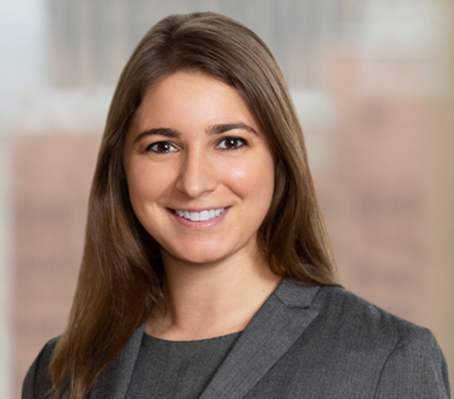
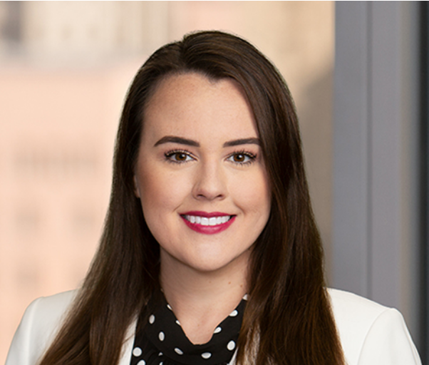
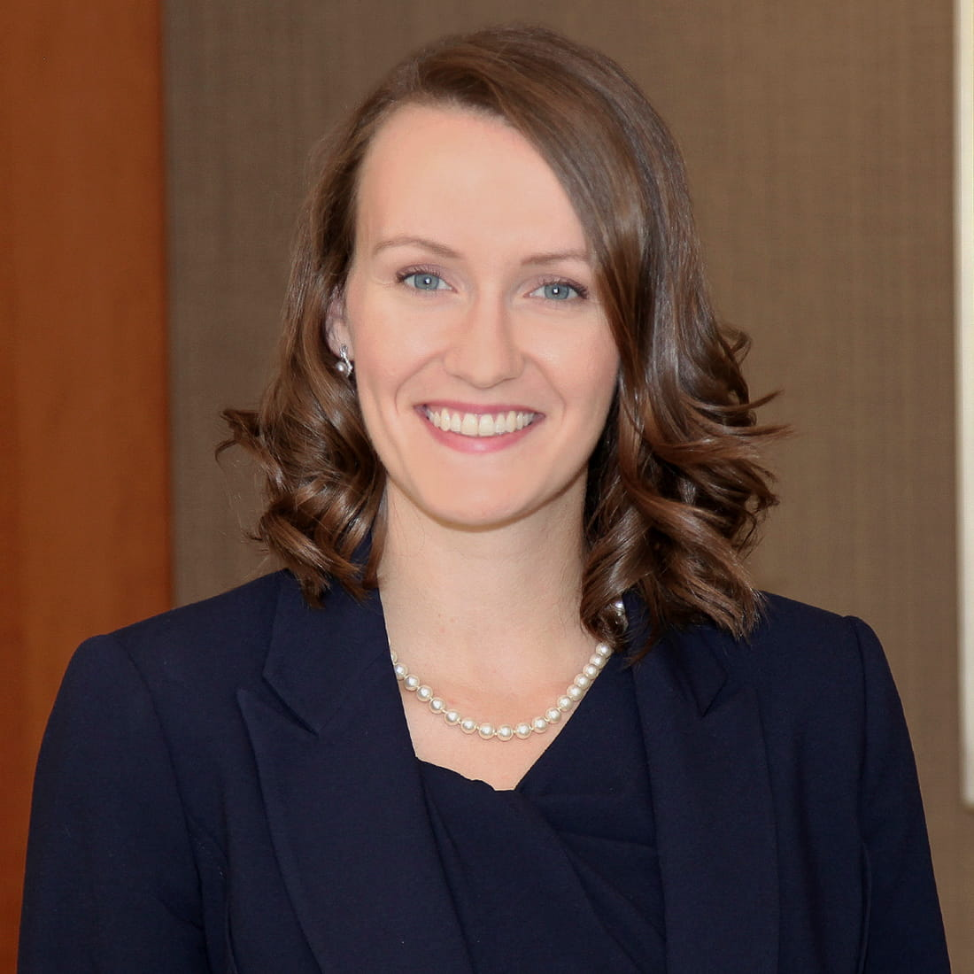
Speaker Contact Information
Victoria Argeroplos, Associate
Jackson Walker LLP
E: vargeroplos@jw.com
T: 713-752-4334
Veronica Polnick, Associate
Jackson Walker LLP
E: vpolnick@jw.com
T: 713-752-4416
Martha Wyrick, Associate
Haynes and Boone, LLP
E: martha.wyrick@haynesboone.com
T: 713-547-2047

