Slide 1
SOUTHERN DISTRICT OF TEXAS BANKRUPTCY BENCH BAR
Tuesday, April 19, 2022
10:45 – 11:15 AM
Getting the Lay of the Land: Negotiating with Landlords
Douglas Greenspan Senior Managing Director A&G Real Estate Partners 445 Broadhollow Road, Suite 410 Melville, New York 11747 doug@agrep.com | Tiana D. Dunn Senior Counsel Jackson Walker LLP 1401 McKinney, Suite 1900 Houston, Texas 77010 tdunn@jw.com
Sean T. Wilson
Senior Associate
Kelley Drye & Warren LLP
515 Post Oak Boulevard, Suite 900
Houston, Texas 77027
swilson@kelleydrye.com

Slide 2

Introduction
  Market Update
  Pre-Bankruptcy – Considerations
  Bankruptcy Filing – Negotiations

Slide 3
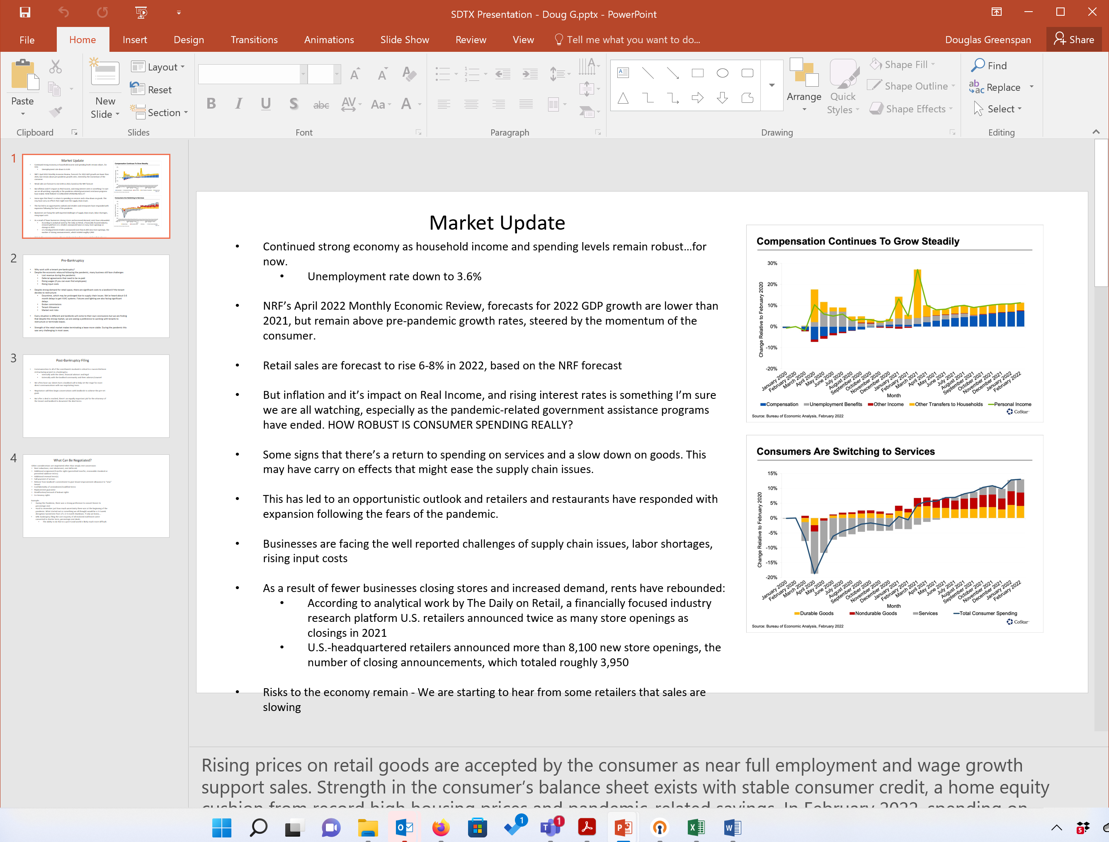
Market Update
“NRF expects retail sales to increase in 2022, as consumers are ready to spend and have the resources to do so.” NRF President and CEO Matthew Shay
Retail sales are forecast to rise 6-8% in 2022, based on the NRF forecast
Starting to see a shift in spending from goods to services
Retailers and restaurants responding with expansion
Challenges remain:
  Supply chain challenges won’t go away,
  Labor shortages,
  Rising input costs
  Interest rates rising
Rents have rebounded

Slide 4

Pre-Bankruptcy
Landlord’s Perspective
  May be unwilling to make concessions when the tenant may file bankruptcy and take “another bite of the apple”
  If making rent concessions, then draft so amendment is void upon default and rejection

Slide 5
Pre-Bankruptcy
  Landlord’s Perspective
  Whether or not the store is profitable and its recent sales trends;
  The value of the store in the shopping center;
  Whether the debtor would reject the lease if the request is denied;
  Whether a replacement tenant would be easy to find; and
  Co-tenancy issues

Slide 6

Pre-Bankruptcy
Tenant’s Perspective
Why work with a tenant outside of a bankruptcy filing?
  Downtime
  Broker commissions
  Tenant Allowance
  Market rent risks
  BK is expensive for everyone
Strength of the retail market makes terminating a lease more viable.

Slide 7




Bankruptcy Filed
WHAT NOW?

Slide 8
Timing Considerations
Debtor’s Time Constraints
  “Case Milestones” Tied to 365(d)(4) Timeline
  ABL Lender
Landlord’s Time Constraints
  Lender approval is typically required
Tenant’s Process
  Communications Internally and Externally

Slide 9





Lease Negotiations
Terms and Concessions

Slide 10

Lease Negotiations
What terms can be negotiated?
Who benefits?
How to consider both Landlord and Tenant perspectives?
Market concessions during Pandemic vs now?

Slide 11
Lease Negotiations
Tenant Asks –
Reduced rent
Forgiveness of base rent and CAM arrears and/or deferral of same
Extended term and additional renewal rights/term(s)
Additional assignment/transfer rights
Extension of tenant rights to assignee
Continuation of exclusive/co-tenancy rights for assignee’s benefit
  Permitted transfer/assignment and renewal rights extending to assignee
Confidentiality of amended terms
Effectiveness of modification – amended financial obligations shall be effective as of amendment date (rather than on confirmation of plan)

Slide 12
Lease Negotiations
Landlord Asks –
Payment of existing arrears within 30/60 days of amendment effective date
Addition of estoppel language – requesting tenant rep and warrant condition of premises, no existing landlord defaults, repairs, improvements, etc.
Negation or limitation of previously negotiated tenant rights –
  Exclusive/co-tenancy rights to become null upon transfer
  Permitted transfer/assignment and renewal rights shall not extend to assignee
Release of landlord’s commitment to provide future/present tenant improvement allowance to assignee
Request replacement guarantor
Effectiveness of modification – all amended terms to be effective upon confirmation of plan
Change to use restrictions

Slide 13


In exchange for Relief

Slide 14
Landlord Protections In Exchange for Relief
Lease Disposition: Assumption of the lease immediately upon execution of rent relief agreement. Voiding of agreement if lease is assigned or rejected, plus return to full rent and an allowed administrative claim for any rent relief already taken prior to disposition of lease.
Timing of Rent Relief: Concessions should commence upon assumption of lease. If parties agree to retroactive rent relief, upon assumption, any overpayment of rent may be credited first against cure amount due to landlord and then against future rent
Type of Rent Relief: Deferral, instead of reduction, of rent. Or rent reduction for a limited duration.

Slide 15
Landlord Protections In Exchange for Relief
Cure of Defaults: It is in both parties’ best interests to quantify the amounts due for cure and pecuniary loss and to provide for prompt payment after assumption. This avoids unnecessary delay and litigation later.
  In re Senior Care Centers, LLC, 607 B.R. 580, 593 (Bankr. N.D. Tex. 2019)
  In re PRK Enterprises, Inc., 235 B.R. 597, 601 (Bankr. E.D. Tex. 1999).
Lease Obligations During Bankruptcy Case: Tenant should timely comply with all lease requirements, including payment of rent. If monetary or non-monetary default occurs and is not cured, amendment should be null and void.

Slide 16
Landlord Protections In Exchange for Relief
Post-Assumption Lease Obligations: Tenant should continue to be responsible for year-end reconciliations and indemnification obligations as they come due in the ordinary course of business and to honor any obligation to indemnify landlord.
Multiple Leases: If landlord is party to more than one lease with tenant, rent relief should be conditioned on all leases being assumed.
Court Approval: Necessary to ensure that the modified terms are enforceable upon a debtor’s breach and are not considered restrictions on assignment.

Slide 17
Landlord Protections In Exchange for Relief – Examples
  EFFECTIVENESS OF LEASE MODIFICATION: The amendments, modifications, and waivers with respect to the Lease set forth in this Amendment shall be effective upon the date that the United States Bankruptcy Court for the Southern District of Texas (Houston Division) (the “Bankruptcy Court”) enters an order approving the assumption or assignment of the Lease, whether pursuant to or in connection with a sale of the Tenant’s assets pursuant to Section 363 of the Bankruptcy Code, confirmation of Tenant’s Chapter 11 plan of reorganization, or a stand-alone motion for assumption or assignment of the Lease (in each case, the “Restructuring Effective Date”); provided, however, that so long as the Tenant is in compliance with all obligations under the Lease as of the date of this Amendment, Tenant’s rent, percentage rent, CAM, taxes and other financial obligations under the Lease shall be deemed amended in accordance with this Amendment as of the date of this Amendment; provided further, however, that in the event the Restructuring Effective Date does not occur or the Lease is rejected in accordance with the Bankruptcy Code, this Amendment shall be null and void and the parties shall revert to their respective positions as if this Amendment never existed. The Tenant shall provide the Landlord with prompt written notice of the Restructuring Effective Date and any information reasonably required by Landlord with respect to such restructuring.

Slide 18
Landlord Protections In Exchange for Relief – Examples
CONFIDENTIALITY: Tenant hereby agrees and acknowledges that Tenant, including its employees, agents, affiliates and consultants, shall not disclose any of the terms of this Amendment including but not limited to the terms herein and the negotiations had with Landlord (including its employees, agents, affiliates and consultants) (the “Landlord Parties”) in connection with this Amendment and the Lease, to any tenant or occupant at the Property or any other party, without first obtaining the prior written consent of Landlord, which Landlord may withhold in Landlord’s sole and absolute discretion. Tenant shall use, as a minimum, the same degree of care to avoid disclosure of hereunder as it employs with respect to its own confidential and proprietary information. Tenant will not make any announcements, disclosures or public statements of any kind regarding this Amendment, including but not limited to the terms herein and the negotiations had with Landlord Parties in connection with this Amendment and the Lease, without Landlord’s prior written consent, which Landlord may withhold in Landlord’s sole and absolute discretion.

Slide 19
Landlord Protections In Exchange for Relief – Examples
  ATTORNEYS’ FEES AND EXPENSES: Tenant shall pay to Landlord all costs and expenses incurred by Landlord in enforcing or preserving Landlord’s rights under this Lease and the security for this Lease, and in all matters of collection, whether or not an Event of Default has actually occurred or has been declared and thereafter cured, including, but not limited to, (a) attorney's and paralegal, consulting and witness fees and disbursements, whether in house or outside counsel; (b) the fees, costs and expenses of any litigation, appellate, administrative, bankruptcy, insolvency, receivership and any other similar proceeding; (c) court costs; (d) the expenses of Landlord, its employees, agents, attorneys and witnesses in preparing for litigation, administrative, bankruptcy, insolvency and other proceedings, including, without limitation, lodging, meals, travel, and attendance at meetings, hearings, depositions, and trials in connection therewith; and (e) consulting and witness fees and expenses incurred by Landlord in connection with any litigation or other proceeding. Notwithstanding the foregoing, in the event litigation is commenced with respect to any alleged default under this Lease, the prevailing party in such litigation shall be entitled to receive, in addition to any award of damages, such sum as the court shall determine as its reasonable attorneys' fees and litigation expenses incurred in connection with such litigation.

Slide 20
Contacts
Douglas Greenspan Senior Managing Director A&G Real Estate Partners 445 Broadhollow Road Suite 410 Melville, New York 11747 doug@agrep.com | Tiana D. Dunn Senior Counsel Jackson Walker LLP 1401 McKinney Suite 1900 Houston, Texas 77010 tdunn@jw.com
Sean T. Wilson
Senior Associate
Kelley Drye & Warren LLP
515 Post Oak Boulevard
Suite 900
Houston, Texas 77027
swilson@kelleydrye.com

