Slide 1
Petition Preparers and the Unauthorized Practice of Law
11 USC § 110

Slide 2
11 USC § 110 Penalty for persons who negligently or fraudulently prepare bankruptcy petitions
11 U.S. Code § 110 (a) In this Section—
(1) “bankruptcy petition preparer” means a person, other than an attorney for the debtor or employee of such attorney under direct supervision of such attorney, who prepares for compensation a document for filing; and
(2) “document for filing” means a petition or any other document prepared for filing by a debtor in a United States Bankruptcy Court or United States District Court in connection with a case under this title.

Slide 3
Who can be a petition preparer?
“A PERSON”
Any individual who charges a fee for their work regarding bankruptcy documents
A Corporation – because the general definition of “person” includes corporations 11 USC § 101(41), corporations can be considered petition preparers

Slide 4
Remedies for Failure to comply with 11 UCS § 110
Disgorgement, Damages, and Fines
Injunctive Relief

Slide 5
Disgorgement § 110(h)(3)
Disgorgement of fees is appropriate where the amount paid exceeds the value of the services provided, where the services had no value, or where the BPP has failed to comply with any of subsections (b) through (g) of § 110.

Slide 6
Damages for Unfair and Deceptive Conduct § 110(i)(I)
Subsection 110(i)(l) authorizes damages for violation of § 110 or the commission of “any act that the court finds to be fraudulent, unfair or deceptive.”

Slide 7
Fines § 110(I)(1) -(2)
BPP “who fails to comply with any provision of subsection (b), (c), (d), (e), (f), (g), or (h) may be fined not more than $500 for each such failure.” § 110(l)(1)
The court may order less than $500 for a violation.
Fines may be trebled under certain circumstances. § 110(l)(2)

Slide 8
Injunction from Specific Conduct § 110(j)(2)(A)
The court may enjoin BPP from engaging in specific conduct, if it finds BPP has:
violated the Bankruptcy Code,
misrepresented BPP’s experience or education as a BPP,
or engaged in other fraudulent, unfair or deceptive conduct, --and--
injunctive relief is appropriate to prevent the recurrence of such conduct.

Slide 9
Injunction from Acting as a BPP § 110(j)(2)(B)
Court may enjoin BPP from acting as BPP if finds -
the BPP has continually engaged in conduct listed in § 110(j)(2)(A), -- and --
an injunction prohibiting the specific conduct would not be sufficient to prevent BPP from interference with the proper administration of the Bankruptcy Code,
BPP has not paid a penalty under § 110, or
BPP has failed to disgorge all fees ordered by the court.

Slide 10
IFA Home Funding et al, v. Juan Castano
10-00304

Slide 11
IFA Home Funding
Offered customers loan modification services for a fee
Let customers believe they were working with licensed attorneys
If the loan modification failed, they would counsel customers on bankruptcy options
Prepared the petition and other bankruptcy paperwork to stop foreclosure
Charged additional fees for bankruptcy work
Advised debtors on bankruptcy process, attended the meeting of creditors as “friend of debtor” or “translator”

Slide 12
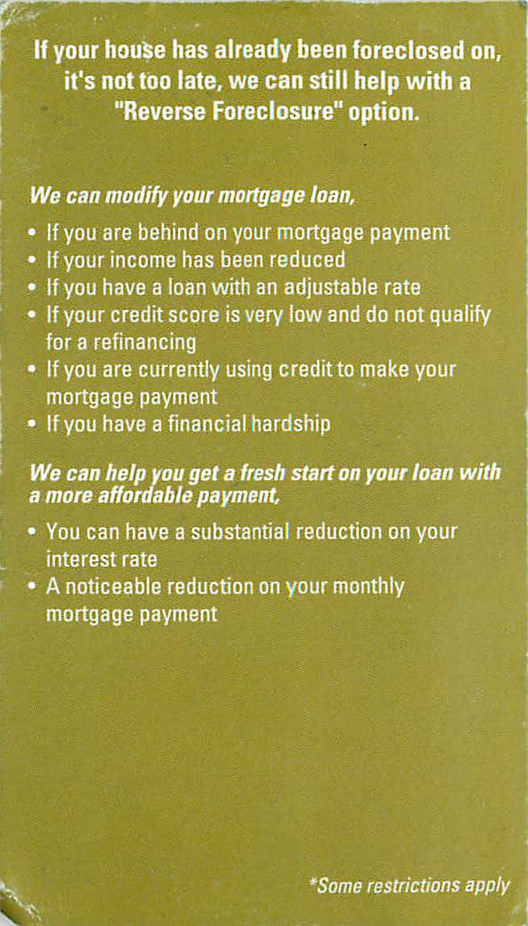

Slide 13
Show Cause Order
Failing to perform any service the agency said it would perform (11 USC § 526(a)(1))
Misrepresenting the services the agency is to provide of the benefits and risks of filing for bankruptcy (11 USC § 526(a)(3))
Failing to make required disclosures under 11 USC § 527
Failing to execute and provide a written contract (11 USC § 528(a)(1)-(2))
Failing to make required disclosures in advertisements (11 USC §528(a)(3)-(b))
Failing to provide the preparer's own social security number to disclose fees (11 USC § 110)
Failing to provide notice to the debtor “that a bankruptcy petition preparer is not an attorney and may not practice law or give legal advice” (11 USC §110(b)(2)(B)(i))

Slide 14
Findings, Sanctions, and Damages
IFA Home Funding was running a unitary business attempting to restructure home mortgage loans, then if it failed, placing individuals in chapter 13 bankruptcy
Ordered to refund fees for both loan modifications and bankruptcies filed
Fined $900.00 for violations of 11 USC § §110, 526, and 528

Slide 15
US Trustee v. Harold W. Higgins
12-03391

Slide 16
Joy Consulting Group
In the business of negotiating solutions for foreclosure, including but not limited to mortgage forbearance agreements, mortgage loan reinstatements, mortgage loan modifications, short sales, and principal and interest reductions
Specifically targeted minorities and Spanish speakers
Would refer debtors to a lawyer if they had eviction proceedings
Provided debtors with documents necessary to file a chapter 13 bankruptcy for an additional fee

Slide 17
Post card advertisement from Joy Consulting Group

Slide 18
Violations under 11 USC § 110, 526, 527, & 528
Failed to include signatures and information required on the petition and other bankruptcy documents
Failed to provide a written contract with terms and disclosures as required under § 528
Failed to provide proper notices and disclosures required under §527
Intentional violation and clear and consistent pattern or practice of violating 11 USC §526 by misrepresenting services provided and providing legal advice without a license

Slide 19
Outcome
Harold Higgins entered into an agreed judgment
enjoining him and any member of his staff from collecting any money from any kind of bankruptcy related work and
refunding $11,000.00 in fees collected
paying $5,000.00 in statutory damages
After evidence was entered demonstrating Mr. Higgins violated the terms of the agreed judgment, he entered into another agreed order assessing monetary sanctions against defendants
Ordered to disgorge an additional $9,150.00 in fees collected

Slide 20
What to look for from a debtor
Amount of arrears owed on their home
Look for programs targeting minorities or non-English speakers
Ask them if they have hired any other person/firm/company to help them with their debts or mortgage
Make sure to ask:
1) Has anyone helped you save your home? File for a loan modification?
2) How much did you pay them? When?
3) Do you have any of the paperwork they gave you?
4) Can you provide any receipts or proof of payments made to them?
Ask the debtor to write down a timeline with names and many detail as they can remember
Have them collect and bring in all the paperwork, receipts, contracts, emails they may have

