Slide 1

We’re from the Government, and We’re Here to Help
Really!
United States Attorney’s Office Civil Chief Daniel Hu
Southern District of Texas AUSA Rick Kincheloe

Slide 2
Disclaimer
Some of this information is subject to change
  Assignments
  Addresses
  Policies
Double check that this information is current before relying on it
Presentation is geared exclusively to bankruptcy matters

Slide 3
Who we are
How we can help
How you can help
Common problems

Slide 4

USAO/SDTX
Represent the United States in most bankruptcy matters
Other components of the U.S. Department of Justice may represent the United States in certain cases
  E.g., Tax Division, Civil Division

Slide 5
Tax Division
USAM 6-5.610
Exceptions:
  Substantive tax issues
  Prominent individuals or corporations
  Dischargeability actions involving attempt to evade a tax or a fraudulent return
  Bankruptcy matters normally handled by USAO if Tax Division is already involved
  Appeals involving the tax matters
Sometimes Tax Division will refer matters to the USAO even if they would normally handle them

Slide 6

Judge Assignments
Houston:
Judge Jones: Rick Kincheloe
Judge Rodriguez: Rick Kincheloe
Judge Isgur: Liz Karpati
Judge Bohm: Jose Vela
Judge Norman: Chad Cowan
Complex Cases: Rick Kincheloe

Slide 7
Judge Assignments
Corpus Christi: Lance Duke
Brownsville: Nancy Masso
McAllen: David Guerra
Laredo: Hector Ramirez

Slide 8
Contact Information
Rick Kincheloe
Richard.Kincheloe@usdoj.gov
(713) 567-9422
Liz Karpati
Elizabeth.Karpati@usdoj.gov
(713) 567-9767
Jose Vela
Jose.Vela@usdoj.gov
(713) 567-9510
Chad Cowan
Chad.Cowan@usdoj.gov
(713) 567-9569

Slide 9
Contact Information
Lance Duke
Lance.Duke@usdoj.gov
(361) 903-7911
Nancy Masso
Nancy.Masso@usdoj.gov
(956) 983-6014
David Guerra
David.Guerra@usdoj.gov
(956) 992-9353
Hector Ramirez
Hector.Ramirez@usdoj.gov
(956) 721-4963

Slide 10
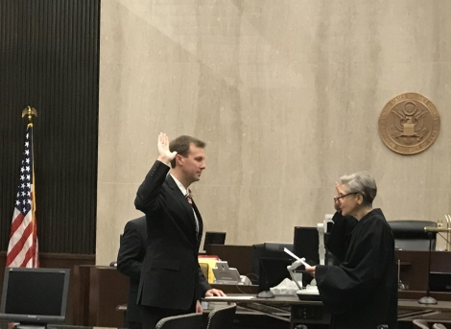
Addresses
U.S. Attorney’s Office:
1000 Louisiana St., Ste. 2300
Houston, TX 77002
Case intake and assignment is handled by the Houston office. Please do not send service to branch addresses.

Slide 11
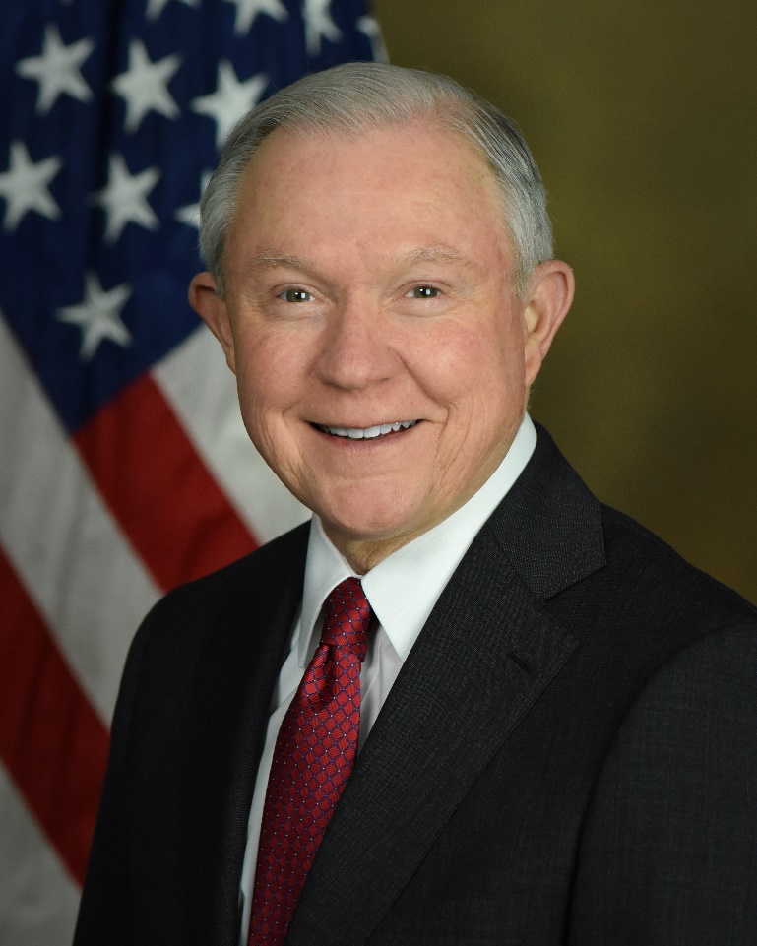
Addresses
U.S. Attorney General:
950 Pennsylvania Avenue, NW
Washington, DC 20530-0001

Slide 12

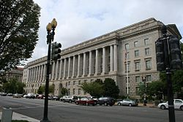
Addresses
IRS: (31 C.F.R. 10.63(c))
1111 Constitution Avenue, NW
Washington, DC 20224
Courtesy Copies:
Houston cases:
1919 Smith Street
M/S 5022HOU
Houston, TX 77002
South Texas cases:
300 E 8th Street
M/S 5026 AUS
Austin, TX 78701

Slide 13




Addresses
Education:
400 Maryland Avenue, SW
Washington, DC 20202
Labor:
200 Constitution Ave. NW
Washington, DC 20210
SBA:
409 3rd St., SW
Washington, DC 20416
EPA:
1200 Pennsylvania Ave., NW
Washington, DC 20460
Customs and
Border Protection:
1300 Pennsylvania Ave., NW
Washington, DC 20229

Slide 14
How can/can’t we help?

Slide 15
How can/can’t we help?
Service of Process
  AUSAs cannot waive service requirements
    Proper service on the United States is a jurisdictional requirement
  AUSAs do not accept service on behalf of the United States
    But courtesy copies by e-mail are still appreciated and will usually generate a quicker response
  Civil Process Clerk is in Houston

Slide 16
How can/can’t we help?
Deadlines
  Can extend deadlines in litigation
  Cannot extend regulatory and administrative deadlines
    Example: Suspensions of production

Slide 17
How can/can’t we help?
Payment Period for Priority Tax Claims
  11 U.S.C. § 1129(a)(9)(C)(ii)
    60 months from the petition date
  No, but…
    May be possible in an exceptional case
    Not enough to propose more recovery than a liquidation
    Balloon payments problematic

Slide 18
How can/can’t we help?
Bar Date
  11 U.S.C. § 502(b)(9)
  “180 days after the date of the order for relief . . .”

Slide 19
How can/can’t we help?
Compromises
  Traditional “offers in compromise” within the meaning of the Internal Revenue Code are not entertained in bankruptcy
  Can compromise aspects of SBA loans
  EPA language
    EPA concerned about preserving the ability of states to enforce environmental law

Slide 20
How can you help?

Slide 21
How can you help?
Bankruptcy Specialists (IRS)
  Assigned by case type, claim size, and debtor name
  Usually the person who signed the proof of claim
  First stop to resolve IRS proof of claim issues
  For Houston: unfiled tax returns should be filed with the bankruptcy specialist
    If cannot reach assigned specialist after several attempts, contact Annie Ray (346) 227-6540

Slide 23
How can you help?
Unfiled Returns
Make an appointment with the bankruptcy specialist in advance to hand deliver a return
If the bankruptcy specialist will accept the return by mail, mail it to the specialist
Do not send returns to the service center
  Typically takes longer
  Harder to find out about the status of the return
Give the IRS time to process late-filed returns

Slide 24
How can you help?
Other disputes
Try to work with the bankruptcy specialist
Tell them what your client disputes and why
Figure out what information they need to correct any mistakes

Slide 25
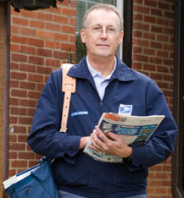
Service
Fed. R. Bankr. P. 9014(b)
  The motion shall be served in the manner provided . . . By Rule 7004 . . .
Fed. R. Bankr. P. 3007(a)(2)(A)(i)
If the Objection is to a claim of the United States . . . in the manner provided . . . by Rule 7004(b)(4) or (5)

Slide 26

Service
Fed. R. Bankr. P. 7004(b)(4) and (5)
Mail claim objection, motion, or complaint and summons to:
U.S. Attorney’s Office for the Southern District of Texas
  ATTN: Civil Process Clerk
U.S. Attorney General
Agency (i.e., IRS, Dept. of Education, etc.)

Slide 27
How can you help?
Initial communication
Case name and number
Court
What are you trying to accomplish
Who have you been dealing with
  We deal with a large number of agencies
What has happened

Slide 28
Common Issues

Slide 29

Common Issues
Late-Filed Individual Tax Returns
    11 U.S.C. § 523(a)(*)
    In re McCoy, 666 F.3d 924, 927 (5th Cir. 2012)
    Late-filed returns are not “returns”
    Tax liabilities for years with late filed returns are not dischargeable
      No return filed – 11 U.S.C. § 523(a)(1)(B)

Slide 30
Common Issues
Interest Rate on Tax Claims
    26 U.S.C. § 6621
      “Federal short-term rate” plus 3%
      “The Secretary shall determine the Federal short-term rate for the first month in each calendar quarter.”
      26 U.S.C. § 1274(d)
    IR-2018-43
      Interest rate is currently 5% for most underpayments
      Check at the beginning of a new quarter
      https://www.irs.gov/newsroom/interest-rates-increase-for-the-second-quarter-of-2018
    Priority claims in chapter 13 cases

Slide 31
Common Issues
Cash Collateral
    Tax liens attach to all assets
      26 U.S.C. § 6321
      “. . . all property and rights to property . . . .”
      Secured tax claim means cash collateral issues in chapter 11 and 13 cases
    Priority of tax lien
      26 U.S.C. § 6323
      “First in time”

Slide 32

Common Issues
Environmental Concerns
    Midlantic National Bank v. New Jersey Department of Environmental Protection, 474 U.S. 494 (1986)
    United States often relies on states to enforce environmental laws

Slide 33
Common Issues
Anything else?

Slide 34
Conclusion

