Slide 1
Electronic discovery meets bankruptcy

Slide 2
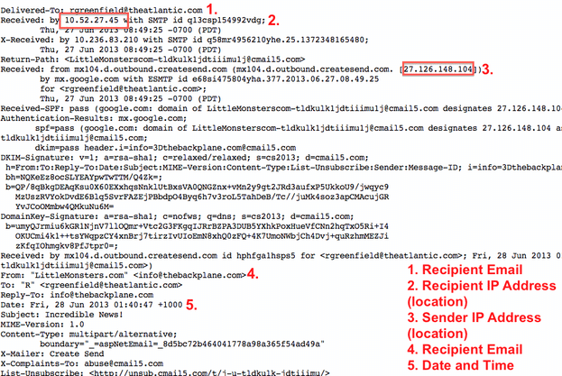
Anatomy of an Email
An email has multiple parts – Most email clients automatically hide the metadata headers associated with your emails
Every email header contains a minimum of 31 metadata tags, including:
Recipient Email
Recipient IP Address
Sender IP Address
Sender Email
Date and Time
Email metadata can be protected via a “container file” such as a PST
Email Header MetaData
Recipient Email
Recipient IP Address (Location)
Sender IP Address
Sender Email Address
Date and Time

Slide 3
What is Metadata?
Metadata commonly refers data attributes of a file.
System-Generated Metadata: Information about a file that is created and applied to a file by a computer process or application. Includes the date a file was created, modified or accessed (“MAC” dates”), and can include where a file was stored (the “file path”).
User Created Metadata: Information about a file that is created and applied to a file by a user. Examples: the addressees of an email or annotations/comments to a document.
Metadata tags are not static and be changed, either purposefully or inadvertently.
Example: A Word document’s create date can be changed by simply copying the file to another storage device.
Proper handling of files includes protecting the files by using software that protects the metadata, or in the case of email, preserving it in a container (PST) file.

Slide 4
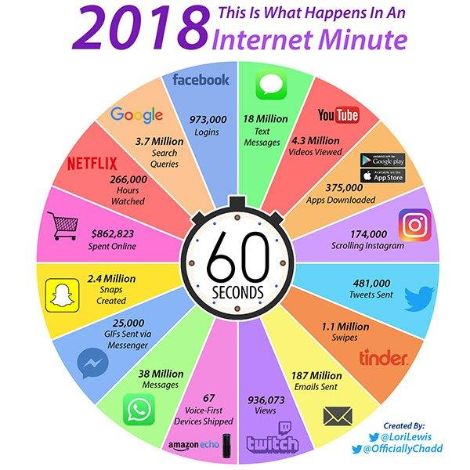

Slide 5
Rule Amendments Quick guide
Rules Amended
Scope Modified
Rule Additions
Rule 1 – Modified to include parties in obligation of securing a just, speedy, and inexpensive resolution
Rules 16 and 26 – Amended to require the parties’ discovery plan to address ESI preservation and inadvertent production
Rule 34 -- requires precision in requests as well as objections
Rule 26(c) -- Modifications to the Scope of Discovery
Proportionality takes the lead
“Reasonably calculated” language deleted
Rule 26(c) -- explicit recognition of court’s authority to allocate discovery expenses
Early Document Requests
FRE 502(d) – Privilege clawback

Slide 6
Technology assisted review sample Framework
TAR focuses on surfacing the most relevant material.
Leverage analytics to organize population into relevance tiers
Prioritize review of the most relevant tier
Review team training
Establish and implement standard quality control processes and reporting
90%
Continuous machine learning leverages attorney work product and rescores unreviewed data sets
Xxx xxxx
Xxxxx xxxxx xxxx xxx xxx
Least relevant data set is set aside and may be eliminated from review based on statistical sampling

Slide 7
Change from traditional Linear review model
When employing the traditional linear review model, key documents are buried in a large collection and must be located by inefficient review of responsive and nonresponsive documents. With TAR, nonresponsive documents can be set aside and reviewers can focus on potentially responsive documents, getting to the important information faster.
Continuous Active Learning (CAL) can surface additional documents for review
Some documents can’t be categorized (insufficient text, Excel, JPG, etc.)
Statistical sampling of likely nonresponsive documents (but not full review)
System identifies and categorizes likely responsive and likely nonresponsive
Not all documents are reviewed
Prioritization of document review —most relevant documents first

