Slide 1
Ethics Considerations in a
Social Media World
Liz Freeman
Mayur Patel, Guzman Law Firm

Slide 2
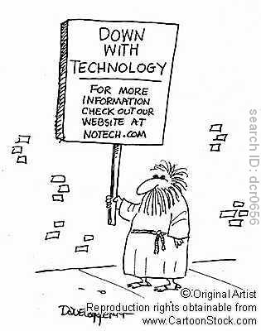
Social media is ubiquitous
YouTube
Facebook
Linkedin
Twitter
Instagram
Blogs
AVVO
Webpages

Slide 3
This is a High Level Survey
Who uses it in personal life?
To promote your practice?
Discovery?

Slide 4
Source: https://techcrunch.com/2017/06/27/facebook-2-billion-users/

Slide 5
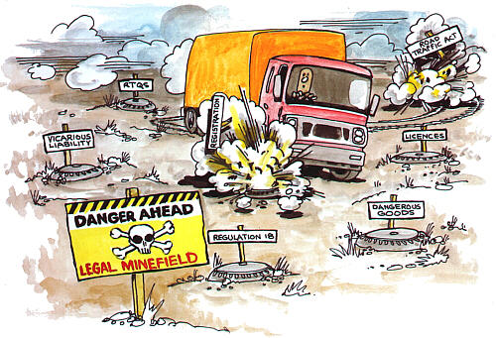
Beware of common landmines

Slide 6
Getting yourself “out there”

Slide 7
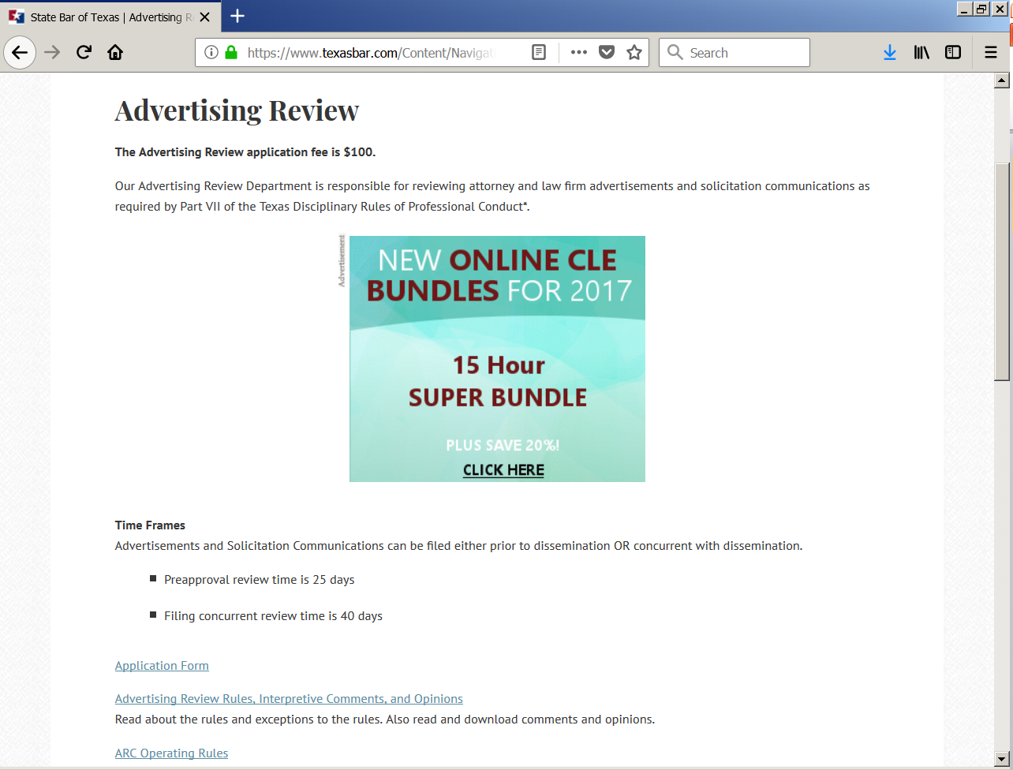
Most Websites should be submitted to the state bar for review

Slide 8
Website Tips
Board Certification | The advertising lawyer or law firm must be competent in the advertised field of law and cannot say they are specialized or certified unless they or their entire firm have been certified by the Texas Board of Legal Specialization.
Past successes or results | Must provide information dealing with the nature of the case, further details into the type of amounts stated in the ad. A disclaimer does not cure the violation. See Rule 7.02(a)(2), Texas Disciplinary Rules of Professional Conduct (TDRPC).
Cumulative results amounts can be used in advertisement without any additional information. | Cumulative results amounts CANNOT be presented in ads without each case fulfilling the required items detailed in Rule 7.02(a)(2), TDRPC, on the same page of the advertisement as the stated result (this includes websites).

Slide 9
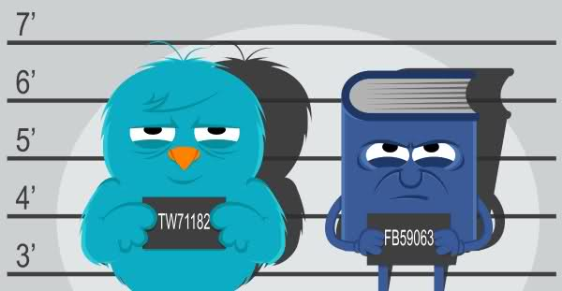
What about “social” social media

Slide 10
Avvo (and the like)
Rule 7.1(a)(2) a communication is false, fraudulent or misleading if it is likely to create and unjustified expectation about the results a lawyer can achieve.
Put disclaimer results may vary based on the facts and circumstances.
Are you creating an attorney client relationship

Slide 11
Linkedin (networking)
Beware of giving access to your contacts!

Slide 12
Discovery through social media

Slide 13
Friending
Rule 4.01 provides in part that, in the course of representing a client, “a lawyer shall not knowingly; (a) make a false statement of material fact or law to a third person….”
Rule 8.04(a)(3) provides that a lawyer shall not “engage in conduct involving dishonesty, fraud, deceit, or misrepresentation.”
Furthermore, Rule 4.03, which governs dealing with unrepresented persons, provides that a lawyer shall not state or imply that the lawyer is disinterested, and further provides that “[w]hen a lawyer knows or reasonably should know that the unrepresented person misunderstands the lawyer’s role in the matter, the lawyer shall make reasonable efforts to correct the misunderstanding.” Additionally, Rule 5.03 subjects a lawyer to discipline if the lawyer orders, encourages, or permits conduct by an agent that would be in violation of the Rules if engaged in by the lawyer.
https://www.legalethicstexas.com/Ethics-Resources/Opinions/Opinion-671

Slide 14
Model Rule 8.2 Limits Criticism of Judges
Model Rule 8.2 provides specific restrictions on criticisms that may be voiced about judges as well as judicial candidates. Model Rule 8.2(a) states: A lawyer shall not make a statement that the lawyer knows to be false or with reckless disregard as to its truth or falsity concerning the qualifications or integrity of a judge, adjudicatory officer or public legal officer, or of a candidate for election or appointment to judicial or legal office. Model Rule 8.2 is generally interpreted in a manner that is consistent with the prohibition against making false statements contained in Model Rule 8.4(c). But Rule 8.2 broadens potential disciplinary liability to statements made with “reckless disregard” for the truth or falsity of the statement when the statement concerns the “qualifications or integrity” of a judge.
Model Rule 8.4 In addition to the specific requirements established in Model Rules 3.6 and 8.2, Model Rule 8.4—sometimes referred to as the “catchall provision”—has been used to discipline lawyers for public statements concerning judges and proceedings.

Slide 16
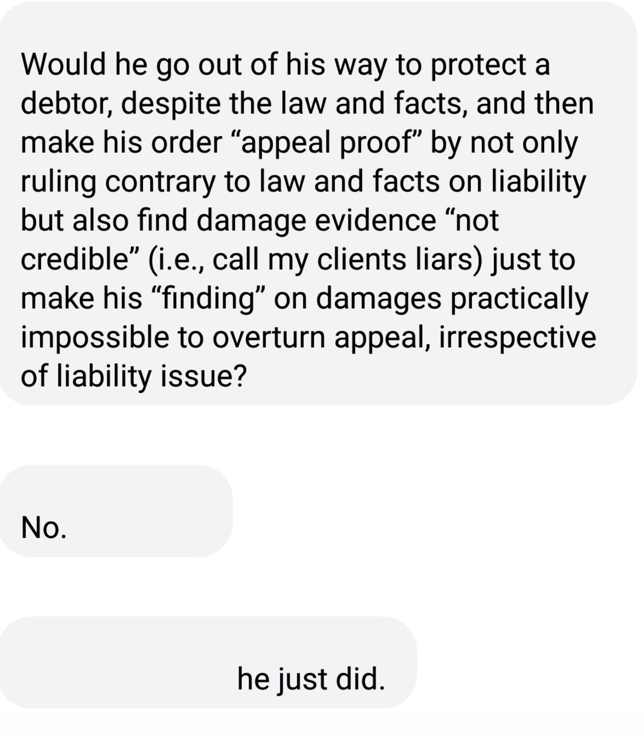

Slide 17
Resources
Texas Disciplinary Rules of Professional Conduct
TYLA Pocket Guide: Social Media 101
ABA Model Rules of Professional Conduct
Texas Disciplinary Rules of Professional Conduct:
http://www.supreme.courts.state.tx.us/rules/atty_rules.asp
The Texas Rules of Disciplinary Procedure
http://www.supreme.courts.state.tx.us/rules/atty_rules.asp
Ethics Hotline - 1-800-532-3947
State Bar of Texas www.texasbar.com 800.566.4616 adreview@texasbar.com
Opinions from the State Bar of Texas Professional Ethics Committee
www.law.uh.edu\libraries\ethics
Texas Center for Legal Ethics www.txethics.org 1-800-204-2222

