Slide 1
What’s New? New Plan, Forms and Rules
Tiffany Castro- Office of William Heitkamp, Trustee
Cristina Rodriguez- Keeling Law Firm
Leigh Ann Tognetti – Marcos D. Oliva, PC

Slide 2
New Plan and Modified Plan
New Uniform Plan (Version 1.1) Effective 02/16/2018 and New Plan Summary Effective 12/1/2017
New Uniform Modification of Confirmed Plan and Motion for Valuation of Collateral (Version 1.1.) Effective 02/16/2018 and New Plan Summary for Proposed Modified Plan Effective 12/1/2017

Slide 3
New Forms
New Chapter 13 forms can be found at http://www.txs.uscourts.gov/bankruptcy-forms and http://www.txs.uscourts.gov/bankruptcy/bankruptcy-forms-filing-fees
Mandatory vs. Suggested Forms

Slide 4
New Rules
New National Rules http://www.uscourts.gov/rules-policies/current-rules-practice-procedure/federal-rules-bankruptcy-procedure
New Local Rules http://www.txs.uscourts.gov/page/bankruptcy-local-rules
New Home Mortgage Procedures http://www.txs.uscourts.gov/bankruptcy/bankruptcy-forms-filing-fees
Judges’ Procedures http://www.txs.uscourts.gov/bankruptcy/bankruptcy-judges-procedures-schedules
See Chart for changes

Slide 5
New Concepts
Trustee will adjust plan payments under more situations
Plan paragraph 4B: Trustee will adjust plan payments on confirmed plans based on timely filed secured claims after confirmation.
Notes:
These automatic adjustments may render plans deficient or infeasible? Trustee may also pursue modification to capture extra disposable income

Slide 7
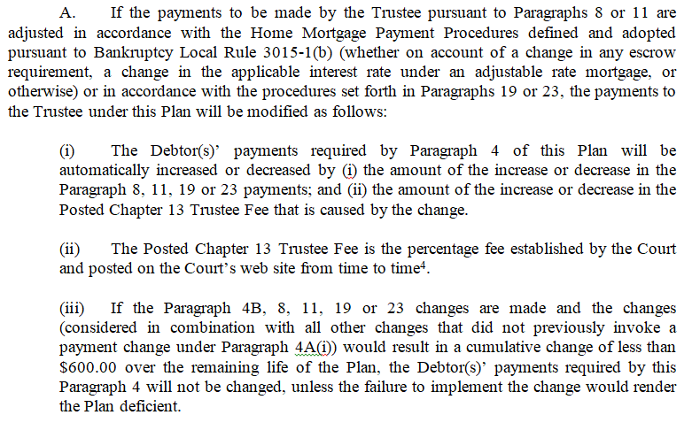
New Concepts Plan Payment Adjustments (continued)
Plan/Mod paragraph 8: Changes to Ongoing mortgage payments on principal residence

Slide 8
New Concepts Plan Payment Adjustments (continued)
Plan/Mod paragraph 11: Changes to Ongoing mortgage payments on non-principal residence real property

Slide 9
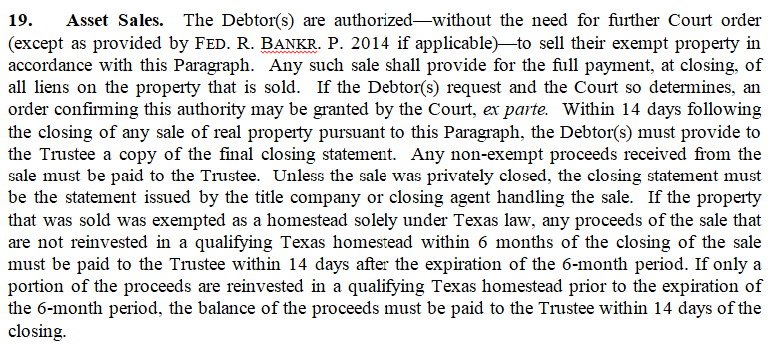
New Concepts Plan Payment Adjustments (continued)
Plan/Mod paragraph 19: Asset Sales

Slide 10
New Concepts Plan Payment Adjustments (continued)
How do you prepare the plan and Debtor for these plan payment adjustments and/or modify the plan after they have been made?
When is it better for Debtor to pass confirmation to after the bar date?
Debtor did not have sufficient supporting documentation
To ensure the payment change will not cause an undue hardship, when there is a known issue

Slide 11
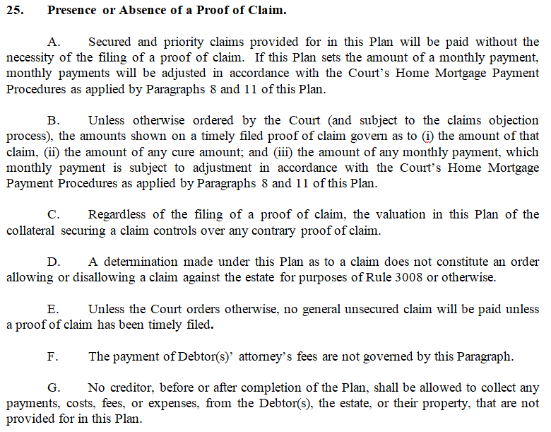
New Concepts (continued)
Trustee will pay per timely allowed claims or per the plan without a timely filed claim.
Notes:
What does paragraph 25D mean? “or otherwise” is very broad!
Also payments returned on amounts with no POC because “paid in full” or unknown acct, etc.

Slide 12
New Concepts Timely and Untimely Claims (continued)
If a claim is filed untimely, Trustee will not change the disbursement to that creditor (up or down), the claim will only be used to update notice and payment addresses.
What is the impact of underestimating or overestimating claims?
What are the risks to protect against when paying without a proof of claim?

Slide 13
Timely and Untimely Claims (continued)
Most creditors have a shorter deadline to file proofs of claim
Secured, priority and general unsecured creditors will have 70 days following the petition date to file their claims
However, if the claimant is a governmental unit, their deadline remains 180 days following the petition date
What are the options for creditors if claims are not timely filed?
Notes:
Can they object to confirmation without a POC after deadline?

Slide 14
Surrender
Surrender vs. Transfer
Surrendering via notice rather than modification
What is the impact of electing to surrender or transfer on future treatment of the claim?
Is there any way to undo a surrender or transfer?

Slide 15
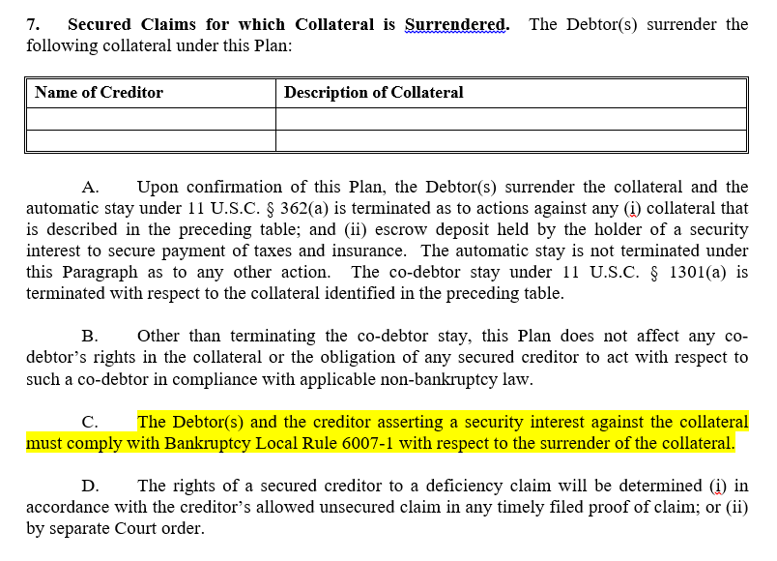

Slide 16
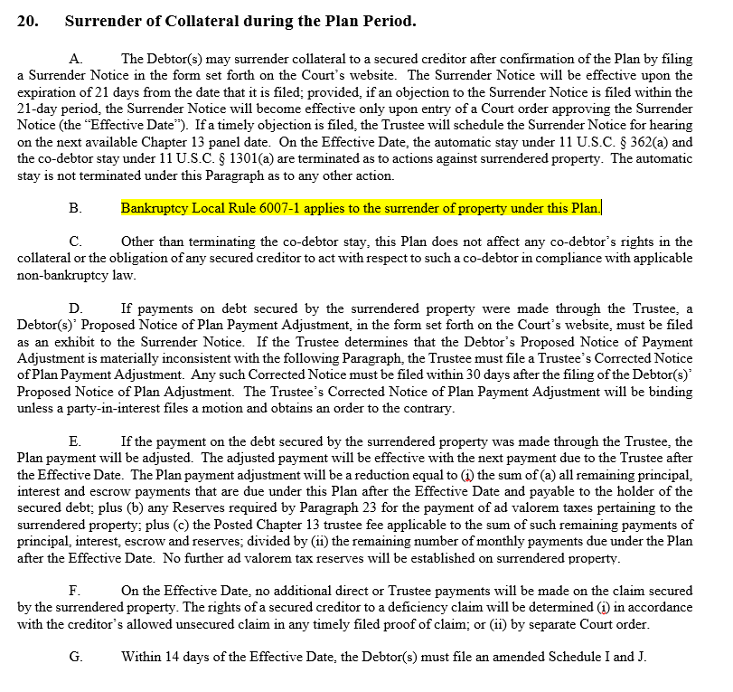

Slide 18
Local Rule 6007
Applies only in Chapter 13 cases
If you surrender SEND AN EMAIL (fax or paper) to opposing counsel and make sure you get a response, if not see Rule 6007 chart.
Remember no agreement can impose personal liability on debtor or limit a debtor’s discharge
The Debtors may use the collateral (if insured) pending retrieval
Both Debtor and Creditor can seek an order to compel compliance
Impose a monthly storage fee 0.5% of FMV secured by first priority lien and enforce such lien, essentially get title to personal property after 228 days from surrender

Slide 19
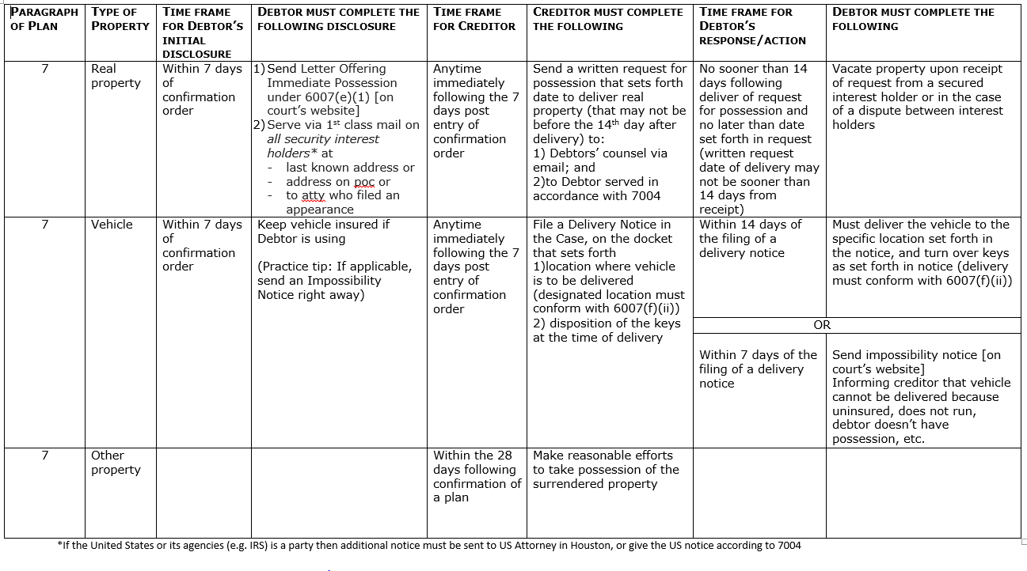
Separate table in the handouts that attempts to layout the time frame for actions that must be taken when something in Surrendered

Slide 20
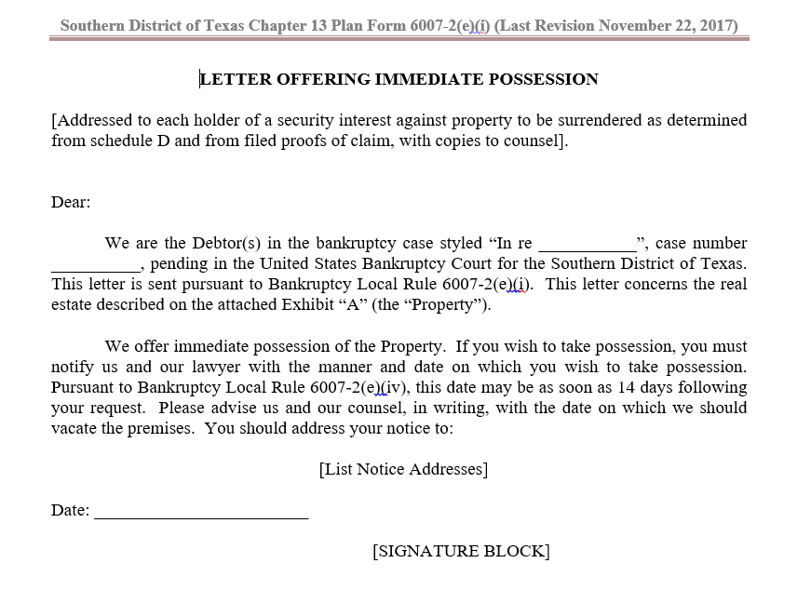

Slide 22
New Noticing Requirements
See Chart of Noticing Cheat Sheet
If the plan takes advantage of certain provisions, additional notice is necessary to make those provisions effective.
Paragraph 8(c) Strip Liens
Paragraph 14 “Dirt for Debt”
What notice is needed for amended plans and modifications?

Slide 23
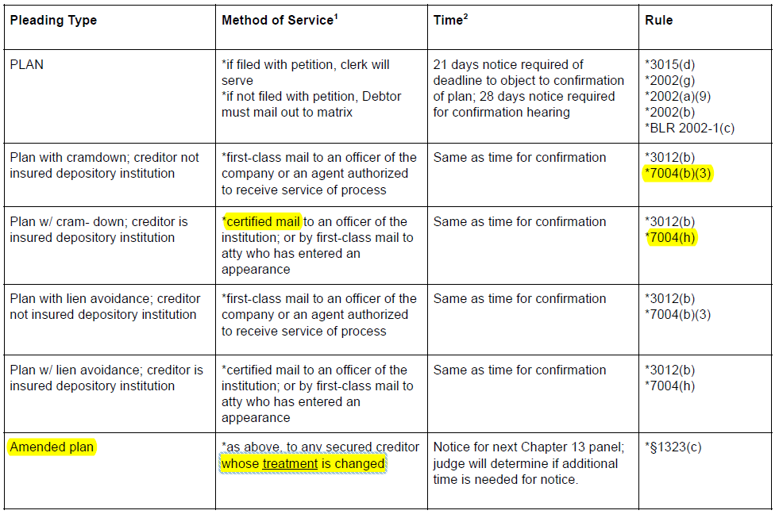

Slide 24
Noticing Tips & Traps
Rule 9006(f). When notice is by first-class mail, add 3 days to all deadlines & notice requirements.
Rule 9036. Service on ECF filers may be accomplished by electronic notice rather than personal service or service by mail (except for summons, 7004 compliant, or subpoena)

Slide 25
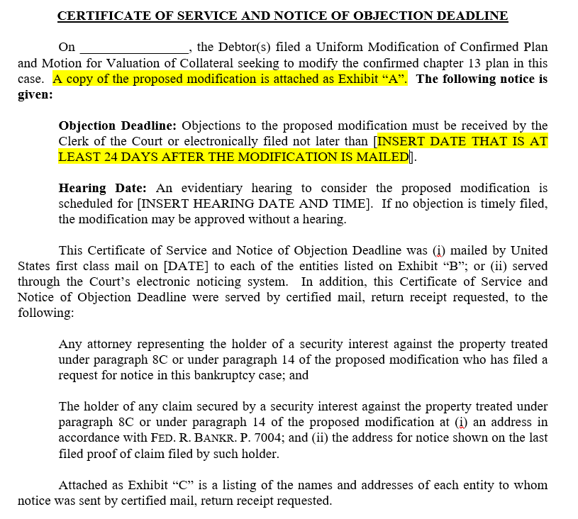

Slide 26
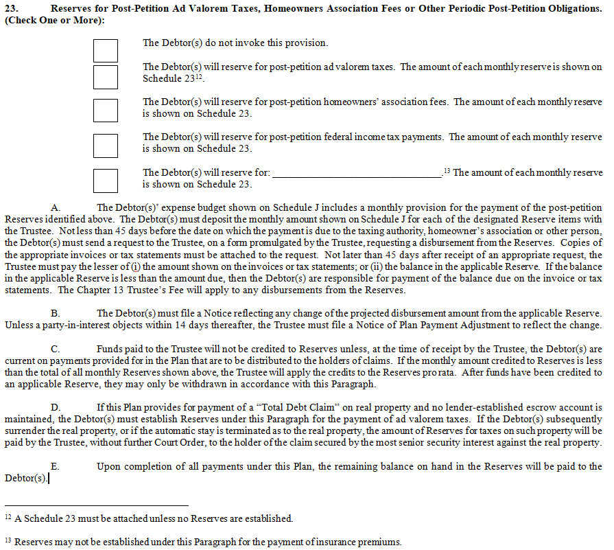
Reserves (Paragraph 23)
Notes:
Categories should not identify recipients or further separate payment among reserves. Not fluid from one to the other.

Slide 27
Reserves (continued)
Ad Valorem Taxes
When is it required?
Only reserve that may not be returned to Debtor upon dismissal
Homeowners Associations
Different from Condominium Fee
Post-petition federal income taxes
Other
What qualifies?
Insurance is never allowed

Slide 28
Plan Payment Adjustments (continued)
Plan/Mod paragraph 23: Debtor requested changes to Reserves

Slide 29
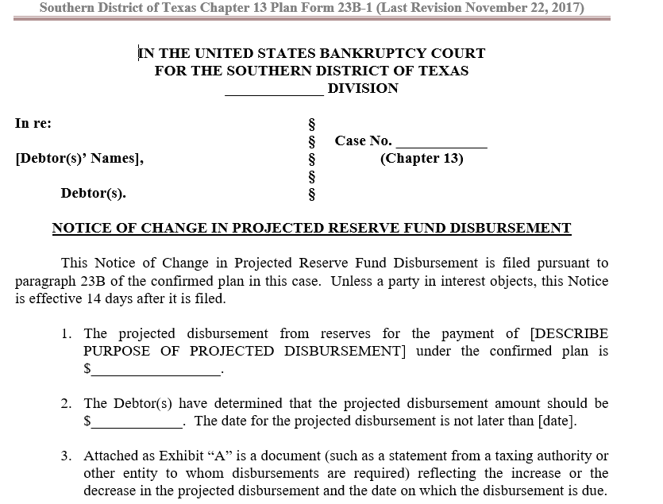

Slide 30
Changes to Attorney Fees
New Fixed Fee Agreement changes not only the dollar amount of the fees, but what items get paid.
For unconfirmed cases that were filed under the previous fixed fee, remember that the $100 wage order fee was not in the fixed fee, only the previous version of the plan. Make sure you obtain an order or other assurance of your payment, if applicable.
The non-standard fixed fee of $5,600 includes a provision for Debtors with 3 or more parcels of real property valued at $50,000.00 or more each and that one or more require implementation of conduit payments or mortgage procedures

Slide 31
Traps/Practice Tips
Remember that the rules were changed now to require the entire plan (not just the plan summary) to be noticed for confirmation. Failure to timely file the plan will mean Trustee will not notice the plan and Debtor will have to cover that cost
Many of the new forms (mandatory and suggested) do not yet have CM/ECF codes. Please note that filing anything as a Generic Motion/Application/Notice, etc. means the Court and the Trustee’s office are not as able to quickly address them. You may want to notify the Trustee and the Judge’s case manager if there is something that needs immediate attention.

Slide 32
Traps/Practice Tips (continued)
How small is too small? Noticing out the plan, Send it creditors double sided 4 pages per side
Make sure to look up registered agent address to have proper notice to secured creditors at time of filing. If the creditor matrix is incomplete, Rule 3002(c)(6) gives creditors right to file a motion for additional time to file their claim.
New objection notice language, negative notice is sufficient for default on objection to claim. Make sure your motions, declarations and orders are updated and straightforward

Slide 33
Traps/Practice Tips (continued)
Rule 5009 (d) Provides that via a motion (not an adversary) a debtor in a chapter 13 may request an order declaring a secured claim satisfied and a lien released under the terms of a confirmed plan.
Consider objecting to late filed secured proof of claims.
Committee Notes from Rule 3002(a) The amendment also clarifies, in accordance with §506(d), that the failure of a secured creditor to file a proof of claim does not render the creditor’s lien void. The inclusion of language from §506(d) is not intended to effect any change of law with respect to claims subject to setoff under §553. (Emphasis added.)
Is SDTX plan language sufficient to overcome §553 setoff?

Slide 34
Questions?
We probably don’t have answers. ☺

