Slide 1
Southern District of Texas Bench Bar Conference
April 18, 2022
Means Testing Scenarios
Practical Application in Unusual (but all too common occurrences)
Mayur Patel
Vicky Fealy
Ravi Ratnala
Hon. Eduardo V. Rodriguez

Slide 2
122A/C-1/2: Similarities
Item | Chapter 7 | Chapter 13
Monthly income | 122A-1, #1-11 | 122C-1, #1-11
Deductions | 122A-2, #5-38 | 122C-2, #5-38
Special circumstances | 122A-2, #43 | 122C-2, #43
Administrative expense (multiplier) | 122A-2, #36 | 122C-2, #36

Slide 3
122A/C-1: Comparisons & Limitations
Item | Chapter 7 (122A-1) | Chapter 13 (122C-1)
Marital status | Exclude separated spouse income | Include both spouses’ income
Marital adjustments | Only on 122A-2, #2-3 | Available, #13

Slide 4
122A/C-2: Comparisons & Limitations
Item | Chapter 7 (122A-2) | Chapter 13 (122C-2)
Marital adjustments | Available, #2-3 | Only on 122C-1, #13
Support for dependent children | None | Available, #40
Retirement deductions | Only involuntary deductions, #17 | All, #17 (involuntary) & #41 (voluntary)

Slide 5
Calculations
All debtors receive minimum deductions for certain items (122-A/C-2, #6-15, #36):
Food, clothing
Healthcare
Housing
Transportation (auto and/or public transportation)
Administrative expense (multiplier)
Chapter 7 debtors can have disposable income and still be under means (see 122A-2, #40-42)
>$15,150 = presumption
<$9,075 = no presumption
>=$9,075 but <=$15,150 = no presumption if it isn’t enough to pay 25% of unsecured debts
i.e. max debt of $36,300 at $9,075 or $60,600 at $15,150
Common errors:
Wrong county
Over-withholding federal income taxes
Voluntary vs. involuntary retirement deductions

Slide 6

Applicable Commitment Period And Business Expenses

Slide 7
Applicable Commitment Period And Business Expenses
In re Arnold, 376 B.R. 652 (Bankr. M.D. Tenn. 2007)
The Arnold court stated that: “Nothing in 11 U.S.C. § 101(10A) indicates that expenses, whether business or personal, may be deducted in determining current monthly income.”
Expenses are not taken into account until calculating disposable income “when business expenses are deducted from current monthly income either:
under 11 U.S.C. § 1325(b)(2)(A) and (B) if the debtor has current monthly income (annualized) less than the applicable median family income, or
(2) under 11 U.S.C. § 1325(b)(3) and 11 U.S.C. § 707(b)(2)(A) and (B) if the debtor has current monthly income (annualized) greater than the applicable median family income.”

Slide 8
Applicable Commitment Period And Business Expenses
Drummond v. Wiegand (In re Wiegand), 386 B.R. 238 (9th Cir. BAP 2008)
Soon after Arnold, the Ninth Circuit B.A.P. agreed in Wiegand “that a chapter 13 debtor engaged in business may not deduct ordinary and necessary business expenses from gross receipts for the purpose of calculating current monthly income as defined under § 101(10A).”
Instead, deductions for business expenses are authorized to be subtracted from current monthly income under § 1325(b)(2)(B) when calculating disposable income.
If business expenses are deducted from gross receipts to determine a chapter 13 debtor's current monthly income, then there would be no need for § 1325(b)(2)(B), which provides for the same deductions.

Slide 9
Applicable Commitment Period And Business Expenses
In re Roman, 2011 WL 5593143 (Bankr. D.P.R. Nov. 16, 2011)
The controversy in Roman was based on Debtor's calculation of his current monthly income. Debtor, following the format and instructions of Official Bankruptcy Form B22C (“Form B22C”), deducted business expenses from his self-employed income, which resulted in below-median income, entitling debtor to a three (3) year commitment period.
Debtor filed amended schedules in which gross receipts were $6,263.21, deductions of $4,754.68 as ordinary and necessary business expenses, and a resulting net business income of $1,508.53. Consequently, the applicable commitment is three (3) years.

Slide 10
Applicable Commitment Period And Business Expenses
In re Roman, 2011 WL 5593143 (Bankr. D.P.R. Nov. 16, 2011)
The Roman Court adopted the mechanical test for determining disposable income as set forth in Sections 1325(b)(1)(B) and 1325(b)(2), by reference to current monthly income determined pursuant to Section 101(10A) and Official Form B22C, and denied the Trustee's Objection.

Slide 11
Applicable Commitment Period And Business Expenses
In re Romero, 2013 WL 241742 (Bankr. S.D. Fla. Jan. 18, 2013)
In Romero, the Debtor calculated his gross monthly business income to be $9,187.70 and business expenses of $6,320.95 per month resulting in net business income of $2,866.75 monthly and $34,401.00 yearly. The median income for a household size of one is $42,053.00 The Debtor therefore filed a 36 month plan pursuant to the Statement of Current Monthly Income.
In establishing the current monthly income, Part I of Form B22C allows a debtor to deduct the ordinary and necessary business expenses from the gross receipts of the operation of its business, the difference of which is reported as business income.

Slide 12
Applicable Commitment Period And Business Expenses
In re Romero, 2013 WL 241742 (Bankr. S.D. Fla. Jan. 18, 2013)
Moreover, Form B22C provides for reporting of business expenses (Form B22C, Lines 3a to 3c), which are not listed as a specific category under “Other Necessary Expenses” (Part IV of Form B22C), but rather included for computation of debtor's current monthly income. (Part I of Form B22C).

Slide 13
Line 13 Marital adjustment
Purpose:
  Schedules I & J include all of the nonfiling spouse’s income in the income portion of the calculation and permits deduction of the nonfiling spouse’s expenses;
  122C-1, however, excludes the nonfiling spouse’s income that is not regularly paid for the household expenses of debtor’s dependents.
  Net effect of the above two calculations on the “bottom line” is similar.
  However, exclusion of income on 122C-1 reduces current monthly income, while Schedules I and J do not.

Slide 14
Line 13 Marital adjustment
Statutorily:
  § 1325(b)(4)(A)(ii), (or 3 or 5 year ACP), requires that the CMI of the Debtor and Debtor’s spouse be “combined”; However
  Unlike § 707(b)(7), “presumption of abuse”, no exception is made for spouses who are:
    Legally separated or
    Living separately.
  NO EXCEPTIONS

Slide 15
Line 13 Marital adjustment
Reason?
  122C-1, Part 3 compares the debtor’s CMI to the state median income, allowing a determination of whether 122C-2 must be used
    (i.e. the Means Test deductions must be used, per § 1325(b)(3), “amounts reasonably necessary to be expended” in calculating disposable income.)
  However, § 1325(b)(3) (disposable income of the “Debtor”) DOES NOT PROVIDE for the inclusion of the income of the debtor’s spouse.
    THUS, Form 122C-2 attempts to honor the “combining” mandated by § 1325(b)(4) by including the non-filing spouse’s income while allowing deductions of the non-filing spouse’s income that are not regularly contributed towards household expenses of the debtor.

Slide 16
Line 13 Marital adjustment
Debtor has 3 options:
Debtor is not married. Fill in 0
Debtor is married and spouse is filing with the debtor. Fill in 0

Slide 17
Line 13 Marital adjustment
Debtor is married and spouse is NOT filing with the debtor.
  Note: for purposes of determining the ACP, §1325(b)(4) refers to the income of “the debtor and debtor’s spouse combined.”
  By checking the third box on Line 13 (Marital Adjustment), a debtor contends that the income of a spouse should NOT be included as income in a non-joint filing.

Slide 18
Line 13 Marital adjustment
Debtor must fill in the amount of the income on Line 13, Column B (spouse), that was NOT regularly paid for the household expenses of the debtor (or dependents of debtor), i.e.
  payment of spouse’s tax liability,
  Spouse’s support of someone other than debtor
  Insurance
  Retirement (mandatory such as 401(k) loans etc.)
  Child support, gym dues, union dues, uniforms, loans from employer, etc.

Slide 19
Line 13 Marital adjustment
  Secured debt payments: cars, boats, etc. which are not going to be listed on
    122C-2, Line 13 (Vehicle Ownership) and/or
    Line 33 (Debts secured by an interest in property).
    watch out for car payments by non-filing spouse (in which only non-filing spouse is liable) and in which car is driven by debtor.
      Those payments must be taken as a marital deduction. Those payments are not considered contributions to Debtor’s household expenses
        See § 707(b)(2)(A)(ii) “monthly expenses of the debtor shall not include any payments for debts.”
  Student loans, repayment plans with the IRS

Slide 20
Line 13 Marital adjustment
Non-filing spouse’s credit card debt payments.
  Deduct the minimum monthly payment unless you can justify higher amounts via monthly statements.
  Caution: some of the expenses charged could be amounts regularly contributed to the household expenses of the debtor. (income)

Slide 21
Line 13 Marital adjustment
It is the UST’s position to oppose any amount listed on 122C-1, Line 13 (Marital adjustment).
Practice Tip:
Do not double dip. If the debtor and non-filing spouse are liable for a car payment, don’t list it as a marital adjustment on
  122C-1, Line 13 (Marital adjustment) and
  a vehicle expense on 122C-2, Line 13 (Vehicle ownership/lease expense).

Slide 22
Line 13 Marital adjustment
Subtract the total
  in Line 13 (marital adjustment) from
  Line 12 (total average monthly income)

Slide 23
Non-Purchase Money Secured Debts
In re Ransome, 131 S. Ct. 716 (2011)
The IRS Collection Financial Standards state, “The ownership costs provide maximum allowances for the lease or purchase of up to two automobiles if allowed as a necessary expense.”
In Ransom, the debtor owned an unencumbered vehicle, but attempted to claim the IRS Local Standards’ vehicle ownership cost under the means test.
The Court held that because Ransom owned his vehicle free and clear of any encumbrances, he incurred no applicable ownership cost and therefore did not qualify for the deduction.

Slide 24
Non-Purchase Money Secured Debts
Courts disallowing the deductions for nonpurchase-money secured debts reason that by using the IRS Collection Financial Standards to assist in the determination of the applicability of an expense, a debt which encumbers a vehicle should arise in the context of new and used car financing and should be limited to provide allowances for the lease or purchase of up to two automobiles and conclude that:
  A nonpurchase-money security interest is not an applicable monthly expense specified under the IRS Local Standards.

Slide 25
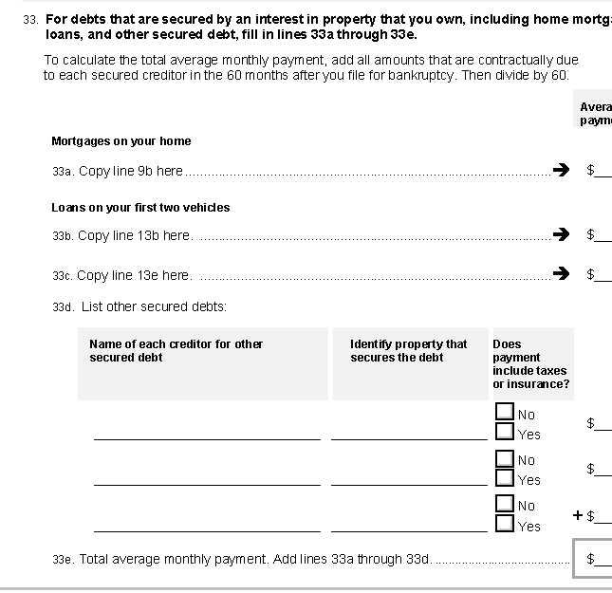
Lease Payments
In re Axline, 618 B.R. 454 (Bankr. N.D. Tex. 2020).
Lease payments are not deductible as a secured debt on Form 122C-2 Line 33 under § 707(b)(2)(A)(iii).

Slide 26
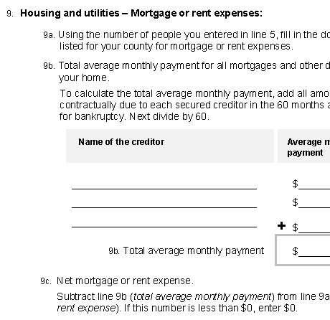
Lease Payments
Debtors are entitled to take rent or lease expense deductions under the IRS Local Standards on Lines 9 and 13 of Form 122C-2.

Slide 27
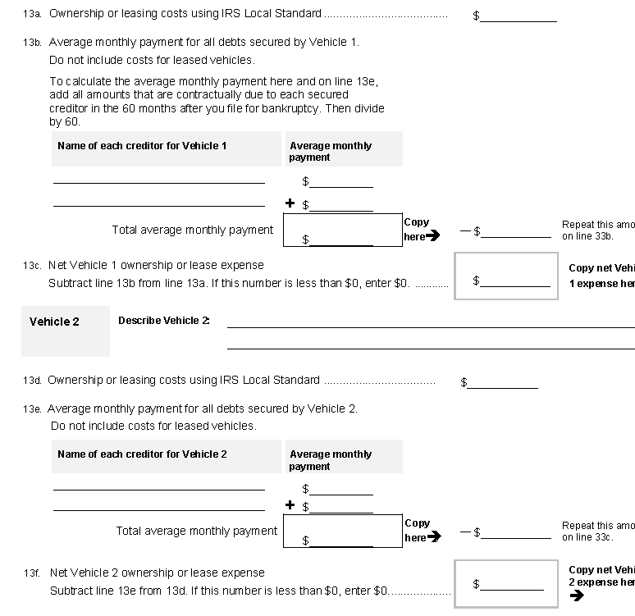
Lease Payments

Slide 28
Lease Payments
Lease payments do not constitute secured debts covered by the provisions of § 707(b)(2)(A)(iii).
They are expenses covered only by § 707(b)(2)(A)(ii).
Therefore, absent special circumstances, debtors are limited to only the applicable IRS Local Standard deduction.

Slide 29
Voluntary Retirement Deductions
(b)Property of the estate does not include— . . .
(7)any amount—
(A)withheld by an employer from the wages of employees for payment as contributions—
  (i)to—
    (I)an employee benefit plan that is subject to title I of the Employee Retirement Income Security Act of 1974 or under an employee benefit plan which is a governmental plan under section 414(d) of the Internal Revenue Code of 1986;
    (II)a deferred compensation plan under section 457 of the Internal Revenue Code of 1986; or
    (III)a tax-deferred annuity under section 403(b) of the Internal Revenue Code of 1986;
  except that such amount under this subparagraph shall not constitute disposable income as defined in section 1325(b)(2);

Slide 30
Voluntary Retirement Deductions
3 Approaches concerning the deductibility of voluntary retirement contributions under the means test.
Courts considering this issue are tested by the interplay between § 541(b)(7)’s hanging paragraph, § 1325(b), § 1322(f), and § 707(b)(2).
Under § 541(b)(7), property of the estate does not include amounts withheld by an employer from the wages of employees for payment as contributions to a qualifying retirement plan, and the hanging paragraph states, “except that such amount under this subparagraph shall not constitute disposable income as defined in section 1325(b)(2).”

Slide 31

Voluntary Retirement Deductions
The three interpretations spurred by this language either:
  allow a debtor to exclude all qualifying retirement contributions from disposable income,
  exclude qualifying retirement contributions from disposable income provided the deductions are consistent with prepetition contributions, or
  only exclude prepetition qualifying retirement contributions from disposable income.

Slide 32
Voluntary Retirement Deductions
Baxter v. Johnson (In re Johnson), 346 B.R. 256 (Bankr. S.D. Ga. 2006)
Johnson is generally attributed with initiating the line of case which hold that voluntary post-petition contributions made by above-median debtors to qualified retirement plans can be completely excluded from disposable income.
“Debtors may fund 401(k) plans in good faith, so long as their contributions do not exceed the limits legally permitted by their 401(k) plans.” Citing § 541(b)(7)(A) &(B), the court stated, ““[A ]ny amount” that is either “withheld by” or “received by” a debtor's employer for qualifying EBPs, deferred compensation plans, tax-deferred annuities, or state-law-regulated health insurance plans “shall not constitute disposable income, as defined in section 1325(b)(2).”

Slide 33
Voluntary Retirement Deductions
In re Garza, 575 B.R. 736, 743 (S.D. Tex. 2017)
The court in Garza had to determine whether the hanging paragraph functioned to allow 401(k) contributions by above-median debtors despite:
  the omission of 401(k) contributions from the list of necessary expenses under the means test, and
  the debtor’s failure to make qualifying retirement contributions prepetition.
  The court stated that the awkward language of § 541(b)(7) did not warrant a reading which would obstruct a clear pronouncement that voluntary retirement contributions were excluded from disposable income.

Slide 34
Voluntary Retirement Deductions
In re Garza, 575 B.R. 736, 743 (S.D. Tex. 2017)
  The court did not accept the argument that § 541(a) and § 541(b) should be read together and therefore found that § 541(a)’s definition of the estate at a fixed point in time, “at the commencement of the case,” did not limit § 541(b)’s list of exclusions from the estate.
  The court bolstered its reasoning by reference to § 541(b)(7)’s use of the phrase “any amount withheld” which did not place a temporal limitation on the exclusion from the estate and to § 1306 which has language designed to expand the estate established by § 541 in its entirety, but not supersede its initial prescriptions.

Slide 35
Voluntary Retirement Deductions
In re Prigge, 441 B.R. 667, 676-677 (Bankr. D. Mont. 2010)
Many courts in the Ninth Circuit have adopted the reasoning of Prigge and held that voluntary 401(k) contributions are always disposable income under § 1325(b).
Prigge focused on § 1325(b)(2) which defines disposable income as current monthly income received by the debtor less amounts reasonably necessary to be expended for the maintenance and support of the debtor and § 1325(b)(3) which requires that for above-median debtors amounts reasonably necessary to be expended shall be determined under the means test of § 707(b)(2).

Slide 36
Voluntary Retirement Deductions
Seafort v. Burden (In re Seafort), 669 F.3d 662, 663 (6th Cir. 2012)
In Seafort, the Sixth Circuit Court of Appeals was tasked with determining whether the income that became available after a debtor completed paying 401(k) loans was projected disposable income or whether that income could be used to begin making voluntary contributions to the debtor’s 401(k) plan because it was excludable from disposable income and property of the estate under § 541(a)(1) and (b)(7).
By reading § 541 and § 1306 together the court concluded that § 541 fixed property of the estate as of the date of filing while § 1306 added to the property of the estate those interests which arise post-petition.

Slide 37
Voluntary Retirement Deductions
Seafort v. Burden (In re Seafort), 669 F.3d 662, 663 (6th Cir. 2012)
Seafort generally agreed with Prigge and reasoned that Congress’s placement of the 401(k) loan repayments within chapter 13 and the placement of the exclusion of voluntary retirement contributions elsewhere was deliberate.
It also concluded that voluntary contributions are not reasonable and necessary under § 1325(b)(3) because they are expressly excluded from § 707(b)(2)(A) & (B) which is the method for determining disposable income for above-median debtors. § 541(b)(7) and its reference to § 1325(b)(2) therefore could only be applied to protect voluntary contributions made prior to the petition date.

Slide 38
Voluntary Retirement Deductions
Davis v. Helbling (In re Davis), 960 F.3d 346 (6th Cir. 2020)
In Davis, the continuing contributions issue (which was not before it in Seafort) reached the Sixth Circuit.
  Concluded the hanging paragraph was best read to exclude from disposable income the monthly 401(k) contributions that the debtor’s employer withheld prior to bankruptcy. ($220.00 monthly)

Slide 39
Voluntary Retirement Deductions
Davis v. Helbling (In re Davis), 960 F.3d 346 (6th Cir. 2020)
    Found the argument that post-petition contributions should be included in disposable income to be unpersuasive.
    The hanging paragraph’s reference to § 1325(b)(2) which does not reference “projected” disposable income and reinforced its conclusion that Congress intended to allow a debtor to continue to exclude from disposable income the 401(k) contributions withheld from her monthly wages prior to bankruptcy.

Slide 40

Tax Refunds
Matter of Diaz, 972 F.3rd 713, 719 (5th Cir. 2020)
Most courts that have considered tax refunds have concluded that current monthly income includes over withholding, or tax refunds, and that debtors are required to commit this income toward payment of their plans.
But the Fifth Circuit recently held in Diaz that a provision from a local form Chapter 13 plan that required Chapter 13 debtors to turn over to the trustee any post-petition income tax refunds in excess of $2,000, without regard to whether debtors were above- or below-median, was invalid.

